Slide 1
Intrusion Detection Framework in Home Automation Using Computer Vision Project Name - Kavach
Mini Project presentation - COM-612
Notes:
© Copyright Microsoft Corporation. All rights reserved. Microsoft, Windows, and other product names are or may be registered trademarks and/or trademarks in the U.S. and/or other countries. The information herein is for informational purposes only and represents the current view of Microsoft Corporation as of the date of this presentation. MICROSOFT MAKES NO WARRANTIES, EXPRESS, IMPLIED OR STATUTORY, AS TO THE INFORMATION IN THIS PRESENTATION.

Slide 2
Introductions
Name
Role
Expectations for today
Notes:
Let’s go around the room and have everyone introduce themselves, their role in the organization, and what you expect to get out of this workshop

Slide 3
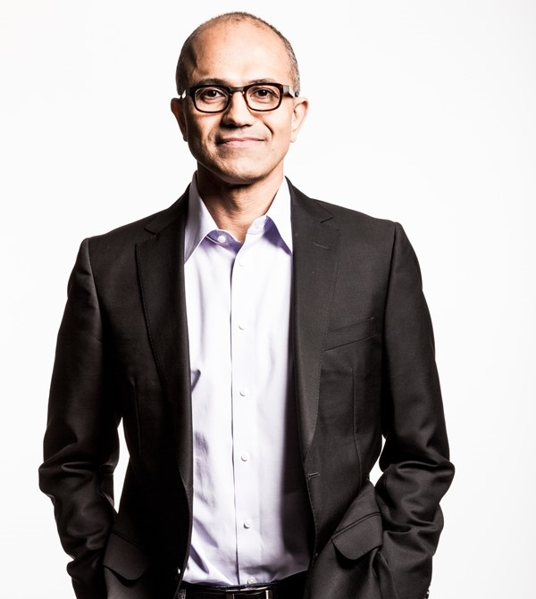
“Security is our top priority and we are committed to working with others across the industry to protect our customers.” Satya Nadella Chief Executive Officer, Microsoft Corporation
Ensuring security to enable your digital transformation through a comprehensive platform, unique intelligence, and broad partnerships
Notes:
Key Takeaway: Microsoft is committed to providing customers a trustworthy platform
Microsoft business is to provide technology via cloud services to our customers and partners. From the top down, we recognize that customers expect security and trustworthiness from our platforms and we are committed to providing that.
CLICK 1
This is the “Microsoft Secure” mission statement that expresses our vision for security that enables organizations to remain productive and to digitally transform using our technologies.

Slide 4
What is an intrusion detection System ?
* Defined as the tools, methods, and resources to help identify, assess, and report unauthorized or unapproved network activity.
* An IDS detects activity in traffic that may or may not be an intrusion.
* IDSes can detect and deal with insider attacks, as well as, external attacks, and are often very useful in detecting violations of corporate security policy and other internal threats.
CISO WORKSHOP OBJECTIVE: Learn how Microsoft can help you achieve your cybersecurity goals
Notes:
Key Takeaway: This is the Threat Protection module of a full day workshop designed for both your organization and Microsoft to learn where Microsoft can help you achieve your cybersecurity goals.
This module will focus the trends, challenges, and recommended strategy for threat protection (including how Microsoft’s capabilities and guidance map into that strategy)

Slide 5
What is an intrusion detection System ?
Lunch
Your strategy
Security management learnings and principles
Kickoff and introduction
Identity and access management
Threat protection
(A) Identify-Protect
(B) Detect-Respond-Recover
Information protection
Joint planning
CISO WORKSHOP OBJECTIVE: Learn how Microsoft can help you achieve your cybersecurity goals
Notes:
Key Takeaway: This is the Threat Protection module of a full day workshop designed for both your organization and Microsoft to learn where Microsoft can help you achieve your cybersecurity goals.
This module will focus the trends, challenges, and recommended strategy for threat protection (including how Microsoft’s capabilities and guidance map into that strategy)

Slide 6
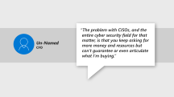
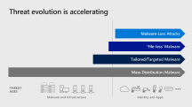
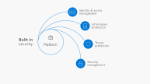
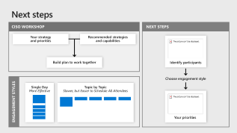
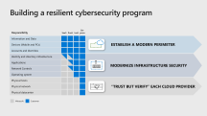
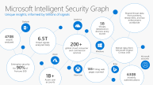
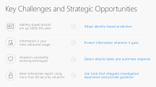
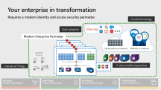
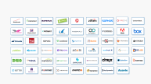
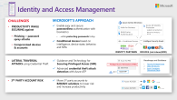
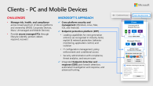
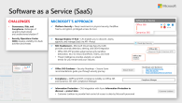
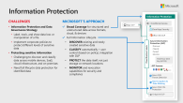
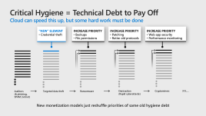
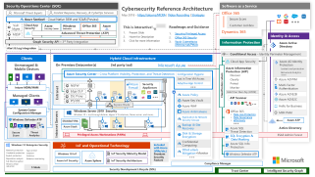
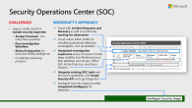
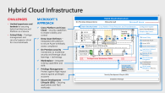
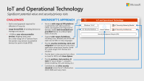

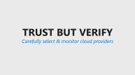
Microsoft Cybersecurity Briefing
CxO View
CISO View – Cybersecurity Landscape + Microsoft Approach
Next steps
Platform
Key Strategies
Cybersecurity Resilience
Accelerating Threats
Intelligence
CISO Workshop
Imperatives & Opportunities
Partners
Digital
Transformation
Security Hygiene
Identity & Access
PC & Mobile Devices
Software As A Service (Saas)
Information Protection
Technical capabilities
Critical Hygiene
Reference Architecture
Cloud Platform
Security Operations Center (SOC)
Hybrid Cloud Infrastructure
IoT And Operational Technology
Security & Trust
Notes:
Key Takeaway: This presentation has an overview of Microsoft’s cybersecurity vision and key capabilities
This slide uses the PowerPoint zoom feature, you can present it and click on each section to skip to it
The Cybersecurity Resilience section in CxO view describe a view into cybersecurity from the C-suite
The CISO view includes context on how we view threats, how we see digital transformation affecting security organizations and strategies, the imperatives and opportunities that these changes bring, and Microsoft’s high-level focus areas for cybersecurity.
The Next Steps includes information on the Microsoft CISO workshop that is available for enterprise customers in the Microsoft Technology Centers (MTCs)
The Critical Hygiene section includes information on critically important security hygiene elements that we are working to solve with organizations like US National Institute of Standards and Technology (NIST), Center for Internet Security (CIS), and others.
The Technical Capabilities section is focused on the Microsoft Cybersecurity Reference Architecture (MCRA) that describes the various technical cybersecurity capabilities from Microsoft and how they interact with each other.
The Cloud Platform Security & Trust section has a summary of key topics for customers evaluating the trust of a cloud provider like Microsoft.

Slide 7
Host Based Intrusion Detection
Network Based Intrusion Detection
Intrusion Detection Systems
Hybrid Intrusion Detection
Honeypots
Passive Systems
Notes:
Key Takeaway: This presentation has an overview of Microsoft’s cybersecurity vision and key capabilities
This slide uses the PowerPoint zoom feature, you can present it and click on each section to skip to it
The Cybersecurity Resilience section in CxO view describe a view into cybersecurity from the C-suite
The CISO view includes context on how we view threats, how we see digital transformation affecting security organizations and strategies, the imperatives and opportunities that these changes bring, and Microsoft’s high-level focus areas for cybersecurity.
The Next Steps includes information on the Microsoft CISO workshop that is available for enterprise customers in the Microsoft Technology Centers (MTCs)
The Critical Hygiene section includes information on critically important security hygiene elements that we are working to solve with organizations like US National Institute of Standards and Technology (NIST), Center for Internet Security (CIS), and others.
The Technical Capabilities section is focused on the Microsoft Cybersecurity Reference Architecture (MCRA) that describes the various technical cybersecurity capabilities from Microsoft and how they interact with each other.
The Cloud Platform Security & Trust section has a summary of key topics for customers evaluating the trust of a cloud provider like Microsoft.

Slide 8
Threat evolution is accelerating
Malware-Less Attacks
‘File-less’ Malware
Tailored/Targeted Malware
Mass Distribution Malware
THREAT AGES
Malware and Infrastructure
Identity and Apps
Notes:
Key Takeaway: Attacker techniques have been evolving rapidly recently
We have also noted an increased maturity in attacker business models where new criminal entrants are able quickly become effective using attack kits and affiliate models (where the new criminals pay the kit authors a percentage of the profits rather than buying it outright)
Mass Distribution Malware - Mass distribution malware has been with us for several decades
Tailored/Targeted Malware - This evolved into malware targeted at individual organization, which has matured into a mainstream attack method
‘File-Less’ Malware - The past few years saw increased investment into evasion of file-based detection using PowerShell to load attack code directly into memory and other similar methods
Malware-Less Attacks - Recently, we have seen the rise of attack campaigns that involve no malware. These frequently target online software as a service (such as Office 365) and involve methods like social engineering, credential theft, and native platform capabilities like document download, forged emails, delegation/forwarding rules, and PowerShell scripts.

Slide 9


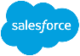


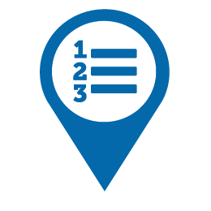


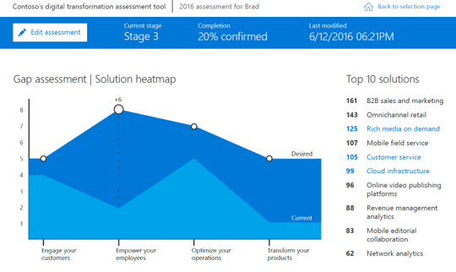
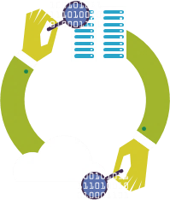
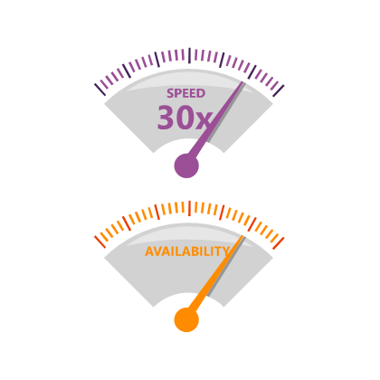
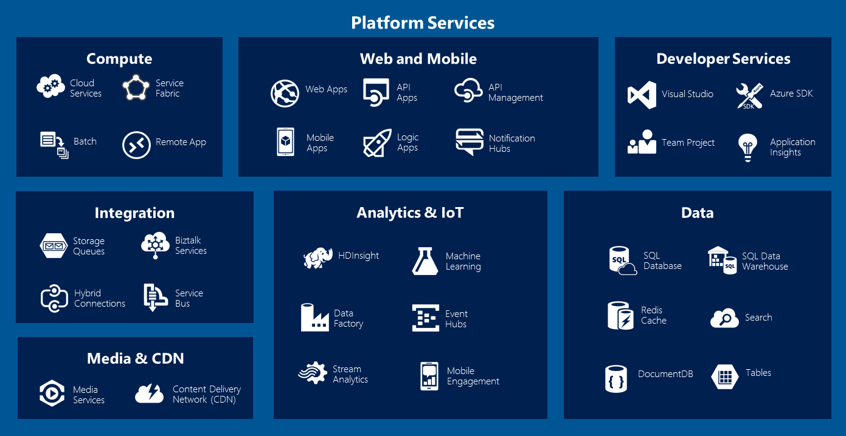
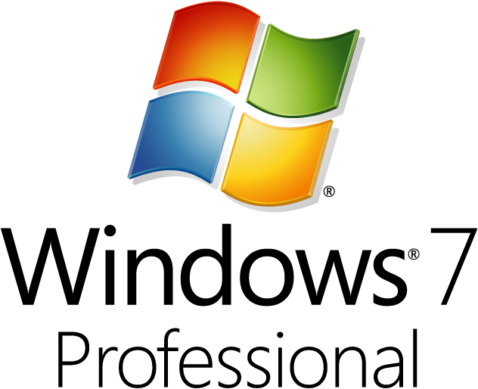





Your enterprise in transformation
Requires a modern identity and access security perimeter
Cloud Technology
SaaS adoption
Modern Enterprise Perimeter
Infrastructure as a Service
Platform as a Service
Internet of Things
1st class mobile experience
ENGAGE YOUR CUSTOMERS
EMPOWER YOUR EMPLOYEES
OPTIMIZE YOUR OPERATIONS
TRANSFORM YOUR PRODUCTS
Notes:
Key Takeaway: Many businesses are transforming rapidly to compete with digital native startups, this change is driving the need for security transformation.
These are the IT transformation components to support the business’s digital transformation that will provide both challenges and opportunities for information security. While the challenges are significant, there is also a massive opportunity to solve longstanding security problems with this next generation of computing.
This represents a classic enterprise security strategy with a network perimeter and a mobile device management component bolted on.
CLICK 1
To be competitive in the marketplace, businesses are seeking to transform using new powerful technologies. The availability of cloud, mobile, and Internet of Things (IoT) technologies is fueling major disruptions in once-settled markets as
Digital native startups leverage this new technology to disrupt longstanding business models
Existing organizations are driving digital transformation to adopt the way they engage customers, empower employees, optimize operations, and offer products to customers
CLICK 2
This instantiates in a couple of different ways that each provide unique challenges for security
Software as a Service (SaaS) adoption to increase collaboration and agility – SaaS provides rapid value without many of the challenges of traditional software deployment and maintenance. While security doesn’t have to update this software, they do need to be aware of their use, assess their trustworthiness, and manage the available security controls
CLICK 3
Demand for a 1st class mobile experience – Business users increasingly have a choice of what devices and apps they can use to get their job done, requiring security to better meet their demands for a great user experience on a secure mobile devices. Business users need full functionality applications for creating value on corporate data beyond the limited functionality email/productivity applications that come with most Mobile Device Management (MDM) providers.
CLICK 4
Internet of things (IoT) is proliferating, and the manageability and visibility of these devices vary greatly from PC and mobile devices such as
Higher volume and limited functionality
Limited resources to run traditional agents
Frequently collect new forms of telemetry with new privacy and security implications
Cloud required to support analytics and IoT management – Even if IT isn’t adopting cloud platforms and infrastructure for its own value propositions, many of the new IoT architectures require cloud services to collect and report on IoT scenarios, requiring Information Security to evaluate the trust and integrate the controls for these platforms.
CLICK 5
This leads to a modern enterprise whose resources and risk are no longer defined by IP subnet addresses.
These changes bring new security challenges, but they also bring new opportunities for security to leverage the same massive storage and computing analytics capabilities to solve these new challenges as well as longstanding classic security challenges.
Note: We have chosen to represent this as a “new perimeter” rather than “perimeter-less” because the core concepts of a security perimeter still apply well to identity control (separation of threats from resources using a consistent set of controls)
We will talk in more depth about how we see this identity-based security perimeter later in the identity and access management module.
Additional Commentary
Security organizations will need to manage different aspects of this shift including the people (culture) and processes (Training) and technology to be successful
Manufacturers of IoT devices will also face new challenges like ensuring and proving the security and safety assurances of their products

Slide 10


Building a resilient cybersecurity program
Responsibility | SaaS | PaaS | IaaS | On-prem
Information and Data
Devices (Mobile and PCs)
Accounts and Identities
Identity and directory infrastructure
Applications
Network Controls
Operating system
Physical hosts
Physical network
Physical datacenter
Establish a Modern Perimeter
Modernize Infrastructure Security
“TRUST BUT VERIFY” EACH Cloud Provider
 | Microsoft |  | Customer
Notes:
Key Takeaway: Cybersecurity resilience requires achieving three complementary objectives
Because cloud services split the operational responsibilities of workloads between the cloud provider and the customer tenant, it is critical to understand the shared responsibility model and what security tasks will be handled by the cloud provider and which ones will be handled by your organization. The workload responsibilities vary depending on whether the workload is hosted on Software as a Service (SaaS), Platform as a Service (PaaS), Infrastructure as a Service (IaaS), or in an On-Premises datacenter.
CLICK 1
Building a resilient security posture in the cloud requires these three approaches
Trust but verify - For responsibilities performed by the cloud provider, organizations should take a “Trust but Verify” approach and evaluate cloud providers to ensure they are performing their security responsibilities well
Infrastructure - For workloads that require managing OS and infrastructure components (PaaS, IaaS, and On-Premises), organizations should take advantage of cloud to modernize their infrastructure and network security strategy as well as integrating security into DevOps process
Modern Perimeter - For data across all workloads, organizations should establish a modern perimeter of consistent, centrally managed identity controls to protect their data, devices, and accounts.

Slide 11
Running Dual Perimeters
ATTACKERS USING IDENTITY TACTICS
SECURING MODERN SCENARIOS (CLOUD, MOBILE, IOT)
MODERN PERIMETER (Identity Controls)
CLASSIC PERIMETER (Network Controls)
FULLY ZERO TRUST
Notes:
Key Takeaway: We are in a transition period where we will be managing two styles of security perimeters to protect both legacy workloads and modern scenarios
The forces that are driving the adoption of the identity perimeter are
The prevalence of attackers using identity tactics (which bypass classic network perimeters)
The need to protect assets where network controls are not available such as cloud services/applications, mobile devices, and Internet of Things (IoT) devices
CLICK 1
An organization will reach a full “zero trust” state once they have migrated all legacy workloads to modern platforms where authorization decisions are based on integrated signals from identity (authentication), devices (configuration, integrity, etc.), the application (data/system sensitivity, and others. This will take some time to achieve for most enterprises.

Slide 12

Evolution of Roles and Responsibilities
MODERN PERIMETER (Identity Controls)
Modern Architectures
CLASSIC PERIMETER (Network Controls)
Legacy Architectures
“STOP THE PRESSES!”
CONTINUOUS VALIDATION
Security roles will change with architectural/operational models
Administration
Manual Resource Administration
Author & Govern Automation
Network → Containment
Containment with Network
Containment at all layers (Net, App, ID, Data, etc.)
Development
Quality Check Before Release
Security SME in DevOps process
Architecture
Project based Engagement
Continuous Engagement & Improvement
Notes:
Key Takeaway: Security roles and responsibilities will evolve with the shifting perimeter and underlying architectures
Technology architectures are shifting in multiple ways:
From large waterfall projects to agile mode of continuous evolution and deployment
From manual processes to highly automated systems
From of individual operating systems to scalable cloud services and containers
Additionally, attackers are increasingly adept at navigating all layers of the stack with credential theft, “living off the land” in SaaS applications as well as custom Line of Business (LOB) applications.
CLICK 1
Security roles, responsibility, and skillsets are evolving to adapt to these new models. While the ultimate mission and “what” that security provides is staying consistent, the tools, skills, and practices of “how” security accomplishes this is changing significantly. These are some key highlights of these changes:
Administration – Administration evolves from manual tasks to authoring, maintaining, and monitoring automated procedures. This will also mean that the focuses of governance tasks will move from a heavy focus on people/process to more of a focus on technology governance. This is a significant benefit for security as automation only offers a single opportunity for human error, whereas a repetitive manual task offers many. Additionally, more scrutiny is typically applied to automation scripts and blueprints vs each iteration of a manual administration task.
Network → Containment - The discipline of network security evolves from a myopic focus on a single technology (networks) to a designing risk containment strategies and controls that span all layers including Network, Application, Identity, Data, and more.
Development Security – As development shifts to a DevOps model, application security professionals become embedded security subject matter experts (SMEs) in the development process rather than passive role in a quality gate.
Security Architecture – This becomes a discipline that is continually engages with each team to continuously improve the architectures and implementations vs. engaging as a initial direction + quality gate role in large waterfall style projects

Slide 13
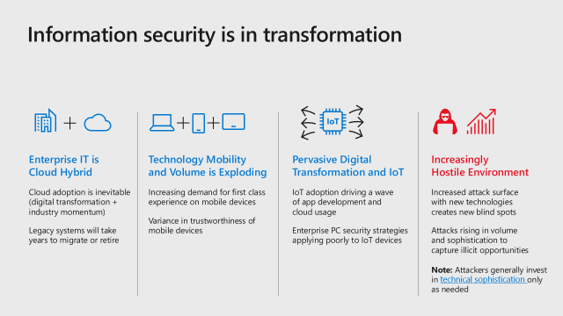
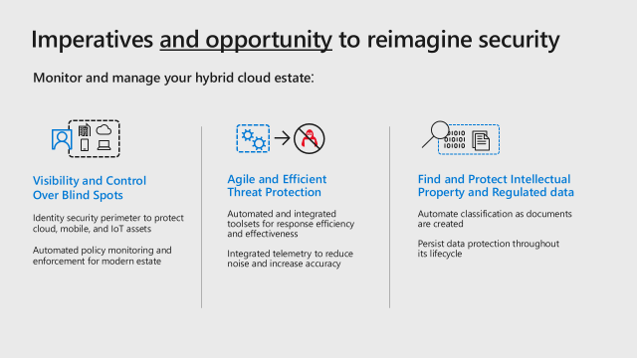
Imperatives and Opportunities
Recognize Fundamental Transformations
Meet Challenges + Embrace Opportunities
DRIVE STRATEGIC OUTCOMES
Security & Compliance Management
Identity and Access Management
Information Protection
Threat Protection
Gain end-to-end visibility into your organization’s security and compliance + manage policy centrally
Ensure only the right people have access to your organizational systems
Protect documents, databases, and emails against leaks, tampering, and destruction
Thwart hackers and recover quickly if attacked
Notes:
Key Takeaway: While the cloud transformation will challenge cybersecurity, it also offers ample opportunity to improve effectiveness and alignment with business objectives.
As Microsoft works with CISOs at our customers, we consistently find similar top priorities across industries and organizations.
The CISO workshop includes our learnings and recommended strategies for these priority areas:
Security Management – Increase visibility and control over your hybrid enterprise estate with integrated guidance and automated policy enforcement and monitoring.
Identity and Access Management – Because most modern attacks involve identity, it’s critical to build a new identity security perimeter to protect assets outside your corporate network (and better protect assets on your network)
Information protection – Protect sensitive information wherever it goes with automatic classification, persistent encryption across devices, and continuous monitoring of data across mobile devices, cloud services, USB sticks, corporate assets, etc.
Threat Protection – Microsoft has build modern protections and detection/response/recovery capabilities designed to rapidly raise attacker cost, many of which are powered by the trillions of signals in our intelligent security graph

Slide 14
Information security is in transformation
IoT
Enterprise IT is Cloud Hybrid
Cloud adoption is inevitable (digital transformation + industry momentum)
Legacy systems will take years to migrate or retire
Technology Mobility and Volume is Exploding
Increasing demand for first class experience on mobile devices
Variance in trustworthiness of mobile devices
Pervasive Digital Transformation and IoT
IoT adoption driving a wave of app development and cloud usage
Enterprise PC security strategies applying poorly to IoT devices
Increasingly Hostile Environment
Increased attack surface with new technologies creates new blind spots
Attacks rising in volume and sophistication to capture illicit opportunities Note: Attackers generally invest in technical sophistication only as needed
Notes:
Key Takeaway: Microsoft is seeing major transformation of almost all aspects of IT and information security
Information Security departments are operating in a world that has changed vastly since the current generation of security best practices were established.
Several key trends stand out:
1. Enterprise IT is Cloud Hybrid
We are expecting enterprise infrastructure (datacenter, networks) to inevitably be a hybrid of on-premises and cloud for some time to come. The attraction of cloud technology value proposition and the difficulty/disadvantages of fully shutting down legacy on-premises technology will drive this hybrid approach.
CLICK 1
2. Technology Mobility and Volume is Exploding
The growth of mobile devices will continue as will the demand for a first class experience with the native applications (vs. the limited functionality of most MDM solutions). Enterprises will also have to start managing the variance in trustworthiness of these devices to better balance risk and productivity.
CLICK 2
3. Pervasive Digital Transformation and IoT
Businesses will be digitally transforming to compete with cloud-native startups that are trying to disrupt existing industries/markets they operate in. This will drive
A lot of Internet of Things (IoT) device usage
Cloud service adoption for storage, processing, analytics, blockchain, etc. to support them
The IoT space will create challenges around
New ways of managing device risk (as PC risk strategies don’t work for many/most IoT devices)
Application development security (as custom/bespoke code will be required to support new models)
CLICK 3
4. Increasingly Hostile Environment
Both the attack surface of the modern enterprise and the threats volume and sophistication are continuing to rise.
We have observed that attackers tend to follow rational behavior. Attackers have to manage their return (successful attacks) for their investment (time and resources on an attack, developing/acquiring tools, or learning skills). Most attackers tend to favor the simplest and cheapest means to achieve their goals. Most attackers will choose a proven method (existing tool or a freely available toolkit) before developing a new tool or technique. The difficult is that many well funded attackers (like nation states) have already developed a large library of sophisticated tools that cost very little to use against another target (and they are willing to invest if necessary for some targets).
Additional Commentary
Enterprise IT is and will be Cloud Hybrid - Most Enterprise IT departments will be operating a hybrid cloud for the foreseeable future as
In an age where almost all enterprises are embracing digital transformation, it will be difficult for IT, business, and security stakeholders to resist the value proposition of cloud services. This will be exacerbated as many vendors will offer compelling new capabilities first (or exclusively) as a cloud service.
It will be difficult and potentially undesirable to fully shut down all on premises datacenters because most enterprises are operating a large volume of legacy applications and there may be compelling reasons to run on premises services for various reasons (bandwidth, connectivity reliability in some geographies, and regulatory reasons)
IoT Devices are different – There are many IoT Devices, but they are generally fixed function devices and operate very differently than general purpose PCs. Because of this, the classic PC security strategies (endpoint agents, host firewalls, network access control, etc.) work poorly or don’t work at all for these devices.

Slide 15
Imperatives and opportunity to reimagine security
Monitor and manage your hybrid cloud estate:
Visibility and Control Over Blind Spots
Identity security perimeter to protect cloud, mobile, and IoT assets
Automated policy monitoring and enforcement for modern estate
Agile and Efficient Threat Protection
Automated and integrated toolsets for response efficiency and effectiveness
Integrated telemetry to reduce noise and increase accuracy
Find and Protect Intellectual Property and Regulated data
Automate classification as documents are created
Persist data protection throughout its lifecycle
Notes:
Key Takeaway – While bringing challenges, this new generation of information security represents an unprecedented opportunity for a fresh approach to solving new and old security problems, as well as the opportunity to transform the relationship with business functions, and leaders.
Monitoring and managing a hybrid of cloud/digital and on-premises legacy assets requires
1. Visibility and control over blind spots in this estate
An identity based security perimeter (we will cover more in module 3)
Automating policy monitoring and enforcement to improve your security management (we will cover more in module 2)
CLICK 1
2. Agile and Efficient Threat Protection
As threats grow, so does signal volume and the difficulty to process them fast enough.
You should increase the efficiency and agility of how you prevent, detect, and respond to threats using the limited available resources you have. Modern preventive controls, automation, and integrated tools/telemetry can radically change your effectiveness here.
CLICK 2
3. Find and Protect Intellectual Property & Regulated Data
Information protection is critical in the age of sophisticated threats and the massive variety of devices, applications and services where data can travel.
It is critical to be able to identify (find/classify/label) it and to tie security protections directly to the data itself
Classification - You need to be able to label the data as its being created and to catch up on the backlog of existing sensitive data that has already been created
Protect the Data itself - You want defense in depth with data controls on devices, networks, etc. but the primary control has to be on the data itself so it follows it regardless of what devices, services, and networks it traverses.

Slide 16
Identity & access management
Information protection
Built in security
Platform
Threat protection
Security management
Notes:
The other side of the platform coin is the built-in security that we make part of our products. This is about building in security tools and technologies into not only Azure and Office 365, but Windows and EMS and the Office clients that we offer to our customers.
Our investments here are guided by the four strategies for success mentioned earlier. The first one, of course, is identity and access management.

Slide 17

Microsoft Intelligent Security Graph Unique insights, informed by trillions of signals
Shared threat data from partners, researchers, and law enforcement worldwide
OneDrive
5B threats detected on devices every month
Outlook
470B emails analyzed
6.5T threat signals analyzed daily
200+ global cloud consumer and commercial services
Botnet data from Microsoft Digital Crimes Unit
Windows
Enterprise security for 90% of Fortune 500
Azure
Microsoft accounts
18B+ Bing web pages scanned
Bing
630B monthly authentications
1B+
Azure user accounts
Xbox Live
Notes:
The center piece of our investment in intelligence is the Microsoft Intelligent Security Graph. This is how we describe the way that we synthesize a vast amount of data from a huge variety of sources. Every day, we practice security operations at a global scale to protect our customers, in the process analyzing more than 6.5 trillion signals.
We operate 200-plus global cloud, consumer, and commercial services. Everything from outlook.com to Xbox Live to Office 365 to Azure, and so on. And with all of those services, we have a tremendous amount of surface area that we defend. Enterprise Security from Microsoft is employed by 90% of the Fortune 500. And so, we see more attacks than most other companies on any given day. We get a lot of information from defending against those attacks.
We block more than 5 billion distinct malware threats per month - that gives us a great deal of signal into what's happening on endpoints, and what the attacks look like these days.
470 billion emails get analyzed for spam and malware by our Outlook.com and Office 365 email services every month – This telemetry helps us understand the full spectrum of phish attacks and the sophisticated and varied methods used by attackers
We process over 630 billion authentications across our cloud services each month, giving us tremendous insight into what is normal behavior when it comes to sign-ins and authentications, and what is abnormal behavior, and how often is it that someone has the right password, but they're not the person they say they are. We learn a lot about defending that really important control point, the identity, by looking across that set of data.
Bing scans about 18 billion web pages every month, giving us really great insight into what people are doing with web scripting technologies when it comes to attacks and phishing campaigns. And we have a great way to look at that and understand how we should help customers defend based on that information.
On top of all of that we layer shared threat data that we get from our partners, from the researchers here at Microsoft who are part of our 3,500-plus people that are full time on security, and law enforcement agencies that we partner with worldwide through our digital crimes unit, as well as botnet data that we collect through the digital crimes unit. All of that intelligence makes up the Intelligent Security Graph.
And why is it a graph? It's a graph because what's really important is connecting these pieces of intelligence, so that these signals are not just individual points of information. The graph brings them together as something that we can draw patterns across. We can learn from one point of data to influence how we interpret another point of data.
So, the Intelligent Security Graph is something that we are very, very heavily invested in at Microsoft. It's something that we feel is unique to us in this industry.

Slide 18
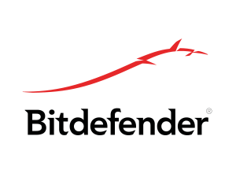
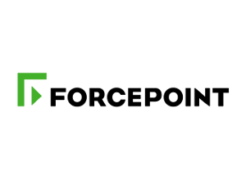
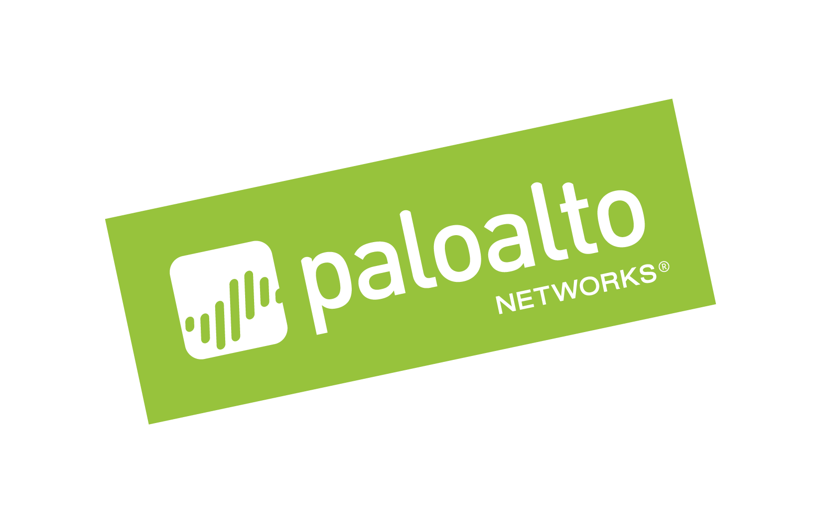
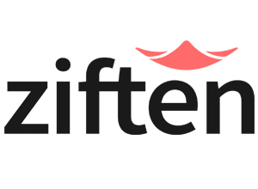
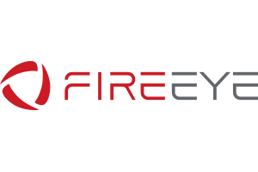
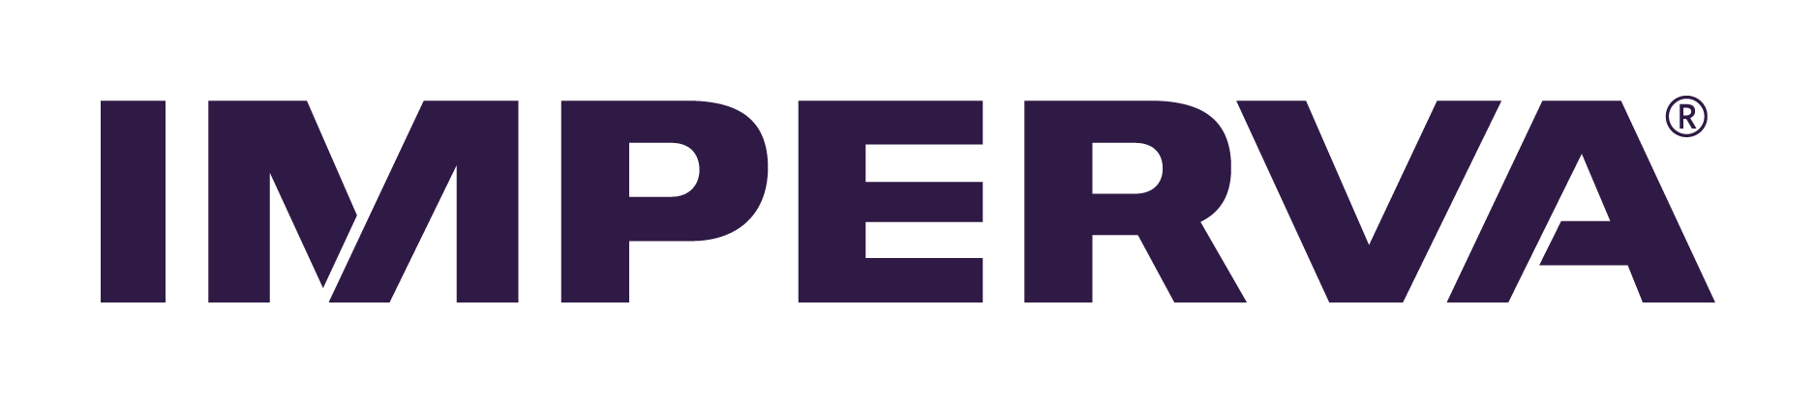


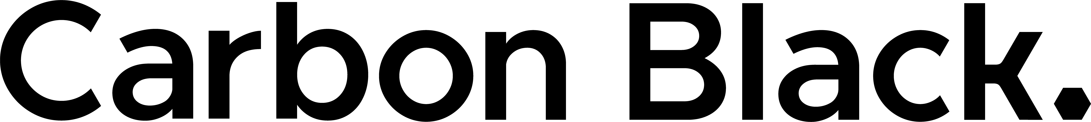
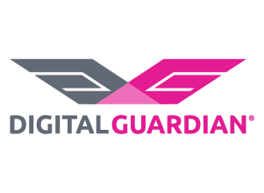
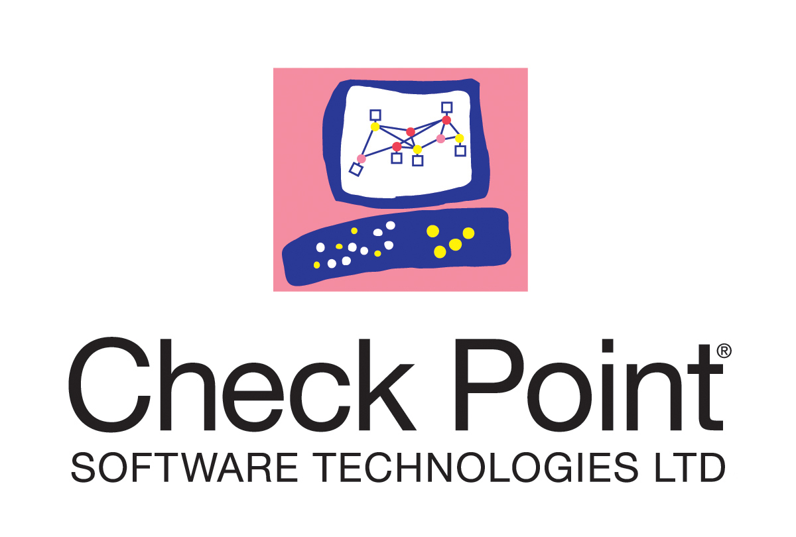
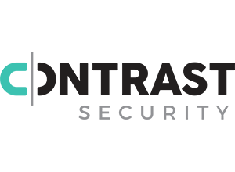

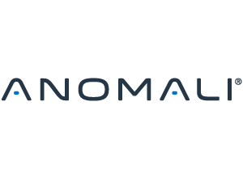



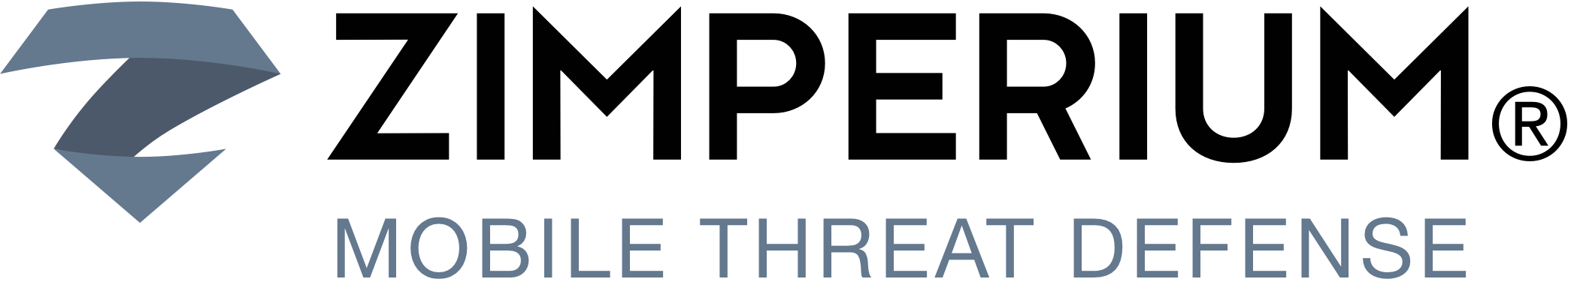
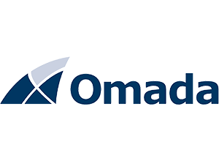
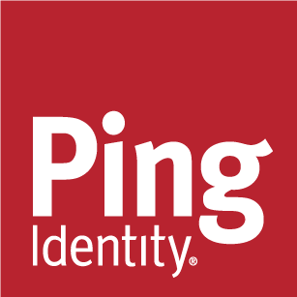
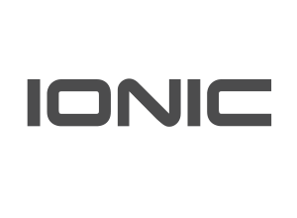

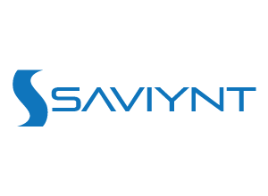


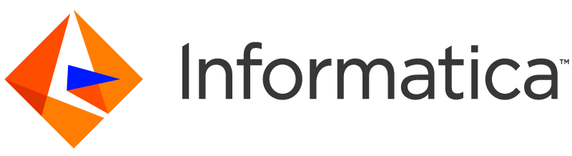


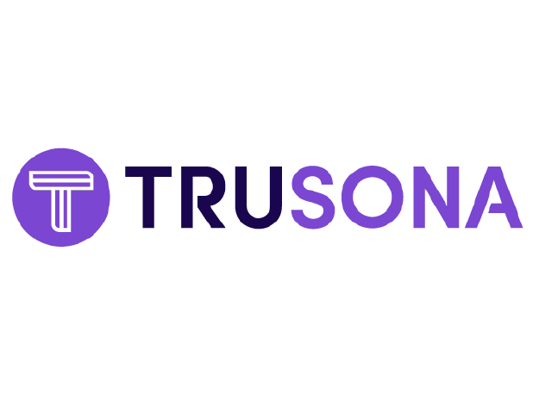
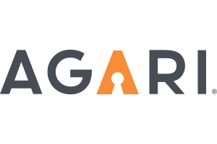


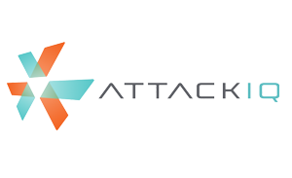



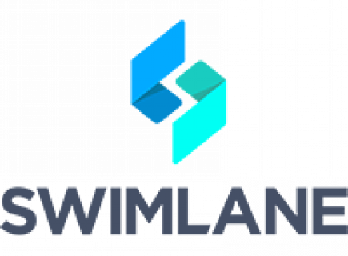
















Notes:
Key Takeaway: These partners are part of Microsoft’s intelligent security association
More information is available at https://www.microsoft.com/en-us/security/association

Slide 19






Active in security and open source communities
Top contributor to GitHub in 2016
~50% of IaaS VMs in Azure run Linux
Board Membership
Notes:
Key Slide Takeaway: Many people are surprised at how active Microsoft is in the security and the open source communities
Microsoft has very actively embraced open source technology, a significant shift from our historical competitive stance.
Microsoft was the top contributor to GitHub in 2016
Over 1/3 of the VMs in Azure running Linux
We participate on boards for many security and open source organizations.
References
GitHub
https://betanews.com/2016/09/15/microsoft-most-open-source-contributors-github/
Linux
Note that this number varies month over month, but ~50% is current as of late 2018
Board Memberships
Cloud Security Alliance –Board of Directors - https://cloudsecurityalliance.org/about/board-of-directors/
Security Advisor Alliance – Advisory Board - https://www.securityadvisoralliance.org/about/board-members/
Linux Foundation –Board of Directors - https://www.linuxfoundation.org/about/board-members
FIDO Alliance –Board of Directors - https://fidoalliance.org/about/board/
FS-ISAC – Advisory Board – not published

Slide 20
Key Challenges and Strategic Opportunities
Identity-based attacks are up 300% this year
Adopt identity-based protection
Information is your most attractive target
Protect information wherever it goes
Attackers constantly evolving techniques
Detect attacks faster and automate response
Most enterprises report using more than 60 security solutions
Use tools that integrate investigation experience and provide guidance
Notes:
Key Takeaway: Microsoft is focused on building solutions for 4 key solution areas: Identity and Access Management, Information protection, Threat Protection, and Security Management

Slide 21
































Security Operations Center (SOC)
Cybersecurity Reference Architecture
April 2019 – https://aka.ms/MCRA | Video Recording | Strategies
Software as a Service
Microsoft Threat Experts
Incident Response, Recovery, & CyberOps Services
Office 365
Security Information and Event Management (SIEM)
Analytics/Automation
Secure Score
Azure Sentinel – Cloud Native SIEM and SOAR (Preview)
Vuln Mgmt
Cloud App
Security
Azure
Security Center
Microsoft Defender
Office 365
Azure
This is interactive!
Present Slide
Hover for Description
Click for more information
Roadmaps and Guidance
Securing Privileged Access
Office 365 Security
Rapid Cyberattacks (Wannacrypt/Petya)
Customer Lockbox
Advanced Threat Protection (ATP)
Dynamics 365
MSSP
Identity & Access
Graph Security API – 3rd Party Integration
Information Protection
Azure Active Directory
Alert & Log Integration
Conditional Access – Identity Perimeter Management
Clients
Hybrid Cloud Infrastructure
Cloud App Security
Azure AD Identity Protection
Leaked cred protection
Behavioral Analytics
Unmanaged &
Mobile Devices
On Premises Datacenter(s)
3rd party IaaS
Microsoft Azure
Azure Information Protection (AIP)
Discover
Classify
Protect
Monitor
Azure Security Center – Cross Platform Visibility, Protection, and Threat Detection
Configuration Hygiene
Just in Time VM Access
Azure AD PIM
NGFW
Azure Firewall
Security Appliances
Adaptive App Control
Classification Labels
Multi-Factor Authentication
Intune MDM/MAM
Managed Clients
Extranet
Edge DLP
Azure Policy
Hold Your Own Key (HYOK)
Azure AD B2B
SSL Proxy
Azure Key Vault
AIP Scanner
Azure AD B2C
IPS/IDS
Hello for Business
Express Route
Azure WAF
System Center Configuration Manager
Windows Server 2019 Security
Window 10 + Just Enough Admin, Hyper-V Containers, Nano server, and more…
Azure Antimalware
Office 365
Data Loss Protection
Data Governance
eDiscovery
MIM PAM
Microsoft Defender ATP
Application & Network Security Groups
Azure ATP
Shielded VMs
VMs
Intranet Servers
Backup & Site Recovery
Azure Stack
Azure SQL
Threat Detection
Active Directory
Secure Score
Threat Analytics
Privileged Access Workstations (PAWs)
Disk & Storage Encryption
SQL Encryption & Data Masking
ESAE Admin Forest
Windows 10 Enterprise Security
IoT and Operational Technology
Included with Azure (VMs/etc.)
Premium Security Feature
Confidential Computing
Azure SQL Info Protection
Network protection
Credential protection
Exploit protection
Reputation analysis
Full Disk Encryption
Attack surface reduction
App control
Isolation
Antivirus
Behavior monitoring
DDoS attack Mitigation+Monitor
Windows 10 IoT
Azure Sphere
IoT Security Maturity Model
Microsoft Defender ATP
Endpoint DLP
Azure IoT Security
IoT Security Architecture
Compliance Manager
S Mode
Security Development Lifecycle (SDL)
Trust Center
Intelligent Security Graph
Notes:
BUILD SLIDE VERSION (Animated Build sequence that takes ~25 clicks)
Key Takeaway: This is the Microsoft Cybersecurity Reference Architecture (https://aka.ms/MCRA) which describes Microsoft’s cybersecurity capabilities and how they integrate with existing security architectures and capabilities.
The latest version of this diagram, associated presentation video (on v1 version currently), and the complementary cybersecurity reference strategies can be found at the links at the top. Links to key guidance are also included for important and complex initiatives like securing privileged access, Office 365, and protecting against attack like Petya/Wannacrypt.
This diagram is interactive, you can hover over any of the capabilities for a quick description and then click on it for more documentation on the capability.
CLICK 1
Most enterprise organizations have Windows and Linux servers (and often applications containers) to protect. Most have also established a basic core set of security capabilities at the network edge / egress points to protect extranet and intranet resources.
CLICK 2
We also commonly find that enterprises also have a range of client devices to support and protect ranging from corporate issued PCs to Bring Your Own Device (BYOD) personally owned mobile devices.
CLICK 3
Many enterprise organizations have established an operational security capability that includes vulnerability management and incident management, which is typically provided by an on-premises Security Information Event Management (SIEM) capability or a Managed Security Services Provider (MSSP).
CLICK 4
Many have also deployed endpoint Data Loss Prevention (DLP) capability to help with information protection needs.
CLICK 5
Most larger organizations have Active Directory as a primary enterprise directory (frequently as part of an identity system that includes other capabilities for identity lifecycle management, credential vaulting, and other needs)
CLICK 6
Most enterprises estates include Software as a Service (SaaS) like Office 365 and other popular services. Some of these are sanctioned and configured by corporate IT, but others are “Shadow IT” adopted by business units and individual user without the knowledge or endorsement of corporate IT.
CLICK 7
Many organizations also operate traditional Industrial Control Systems (ICS) including Supervisory Control and Data Acquisition (SCADA) technology. Many are also operating or planning to adopt Internet of Things (IoT) technology for both internal systems and customer product offerings.
CLICK 8
Additionally, the scope of enterprise infrastructure has grown into a hybrid state that incorporates Infrastructure as a Service (IaaS) and Platform as a Service (PaaS) from Microsoft Azure as well as other IaaS providers.
Pausing for a moment, this leaves most enterprises with a “hybrid of everything” estate to manage and secure, which is quite challenging given the steadily increasing volume and sophistication of cybersecurity threat actors.
CLICK 9
The foundation of Microsoft’s cloud services and products starts with our investments in security and compliance, many of which have been made available to our customers in some form:
Trust Center – Microsoft offers the most comprehensive set of compliance offerings of any cloud service provider. We transparently provide information on how we meet or exceed those standards in our trust center.
Compliance Manager - We built a capability to help you manage your compliance requirements (based heavily on what we learned while managing compliance of our cloud services such as an extensive mapping of controls across standards)
Security Development Lifecycle - We have also published documentation from our industry leading security development lifecycle openly to help you with securing your applications. This has recently evolved into a Secure DevOps toolkit for Azure - https://azsk.azurewebsites.net/
Intelligence Security Graph – Through the course of supporting, operating, and securing our cloud services and Windows PCs, Microsoft has accumulated a massive set of first party threat intelligence (processes about 6.5 trillion signals per day) that we use to protect our cloud services, IT environment, and customers. Many of the products in this architecture have integrated intelligence and analytics from the security graph directly into threat detection and alert enrichment capabilities.
CLICK 10
Familiar security capabilities from popular vendors are available in the Azure Marketplace to enable customers to extend on premises controls to the cloud. Additionally, Microsoft has built Azure Firewall, a native “Firewall as a Service” capability in Azure that includes several advanced technologies and greatly simplifies firewall deployment and management.
CLICK 11
Microsoft has invested into Azure Security Center (ASC) to enable you to
Protect servers and workloads
Detect and correct common misconfiguration issues such as
VMs exposed directly to the internet
Missing Web Application Firewalls (WAFs) for web applications
Out of date patches and antimalware signatures
…and many others
Leverage cutting edge capabilities in Azure like machine learning to suggest firewall rules and application whitelists (to allow/block which files can run on servers)
CLICK 12
Microsoft has also invested heavily in other Azure security capabilities such as Distributed Denial of Service (DDoS) mitigations, key management, ransomware-resistant backup archives, confidential computing capabilities to protect data while its being processed, and many more.
CLICK 13
Microsoft has also continued to invest into on-premises security capabilities for Windows Server (including Shielded VMs) and Azure Stack (which provides the ability to run Azure services in your on-premises datacenter)
CLICK 14
Microsoft has also focused heavily on device security with
System Center Configuration Manager and Intune MDM/MAM for cross platform security and management across Windows, Linux, Mac, iOS, and Android
Windows 10 Enterprise Security - An extensive set of platform capabilities to protect against ever-evolving attacks
Windows Defender ATP – Advanced endpoint detection and response (EDR) capabilities to rapidly detect and recover from attacks as well as management, monitoring, and security planning capabilities to keep devices healthy and secure.
CLICK 15
Based on lessons learned from credential theft and similar attacks, Microsoft has invested in securing privilege access including privileged access management, advanced credential/identity attack detection and privileged access workstation (PAW) architectures. Our PAW investments includes
Publishing Guidance – We have published detailed installation instructions for customers to build their own PAWs
Platform Security – We protect our IT Environment and cloud services with a full admin workstation program (internally called Secure Access Workstations or SAWs)
CLICK 16
Because of how critical identity is to security, Microsoft has invested heavily in security capabilities to protect and manage cloud and on-premises identities spanning multi-factor authentication, biometrics, hardware protection of credentials (via TPM and virtualization based security), applying threat intelligence + machine learning to authentication attempts, and more.
CLICK 17
Identity is also critical for protecting data and operational availability as it’s frequently the only control type available across modern IoT/mobile/etc. devices and cloud services. Organizations should focus on build an identity security perimeter to consolidate management of authentication and access controls and enforce consistency. Microsoft has invested into Conditional Access to enable simple (and powerful) visibility and policy control of this new perimeter.
CLICK 18
Microsoft has invested across our tools to enable integration with your existing Security Information and Event Management (SIEM) solution.
CLICK 19
Microsoft has built Advanced Threat Protection (ATP) technology to provide deep context on key technical elements of the modern estate (Endpoint, Identity, Email, and more) to rapidly detect and remediate threats across them. Microsoft also offers professional services to help you investigate incidents in your environment as well as to hunt for potential existing threats. This will enable you to transform your SOC using the massive set of Microsoft threat intelligence in the intelligent security graph (bottom right of slide) and integrate these with your existing capabilities using the Graph Security API.
CLICK 20
Microsoft also built Azure Sentinel, a cloud native SIEM and SOAR capability, into Azure to help you with breadth of visibility to collect security data from across your enterprise estate including Microsoft, AWS, other clouds, and on premises assets. Azure Sentinel uses machine learning to reduce alert fatigue (up to 90% in private preview) and native cloud capabilities (like automation) to simplify your data collection, SIEM maintenance, and incident investigation + remediation.
CLICK 21
Microsoft has built several Office 365 security capabilities to enhance your security planning (Secure Score), add additional explicit approval steps before Microsoft support can access your data for support issues (Customer Lockbox), and data protection technologies built into the platform.
CLICK 22
Azure Information Protection – Protects information at the file itself so the encryption and policy control can follow files wherever they go (Cloud, Devices, USB drives, etc.).
CLICK 23
Cloud App Security is a Microsoft Cloud Application Security Broker (CASB) offering that provides a wide array of security capabilities for SaaS including Shadow IT Risk management, Policy Monitoring and Enforcement, Information Protection, and incident detection/response/recovery.
CLICK 24
Additionally, Microsoft has invested in advanced security capabilities for data in SQL to protect against common threats and simplify information protection management and policy.
CLICK 25
Microsoft is also investing heavily into OT and IoT security to help manage and secure existing (brownfield) platforms, provide secure (greenfield) platforms, and help manufacturers quickly determine what level of security they need and enable them to rapidly and easily achieve that.
CLICK 26
We understand this is a lot of capabilities to plan for, so we have built several prescriptive roadmaps to help organizations quickly mitigate risk from critical and complex cybersecurity challenges.
Feedback
We are always trying to improve everything we do at Microsoft and we need your feedback to do it! You can contact the primary author (Mark Simos) directly on LinkedIn (https://aka.ms/markslist) with any feedback on how to improve it or how you use it, how it helps you, or any other thoughts you have.

Slide 22
Security Operations Center (SOC)
Cybersecurity Reference Architecture
April 2019 – https://aka.ms/MCRA | Video Recording | Strategies
Software as a Service
Microsoft Threat Experts
Incident Response, Recovery, & CyberOps Services
Office 365
Azure Sentinel – Cloud Native SIEM and SOAR (Preview)
Secure Score
Vuln Mgmt
Cloud App
Security
Azure
Security Center
Microsoft Defender
Office 365
Azure
This is interactive!
Present Slide
Hover for Description
Click for more information
Roadmaps and Guidance
Securing Privileged Access
Office 365 Security
Rapid Cyberattacks (Wannacrypt/Petya)
Customer Lockbox
Advanced Threat Protection (ATP)
Dynamics 365
MSSP
Identity & Access
Graph Security API – 3rd Party Integration
Information Protection
Azure Active Directory
Alert & Log Integration
Conditional Access – Identity Perimeter Management
Clients
Hybrid Cloud Infrastructure
Cloud App Security
Azure AD Identity Protection
Leaked cred protection
Behavioral Analytics
Unmanaged &
Mobile Devices
On Premises Datacenter(s)
3rd party IaaS
Microsoft Azure
Azure Information Protection (AIP)
Discover
Classify
Protect
Monitor
Azure Security Center – Cross Platform Visibility, Protection, and Threat Detection
Configuration Hygiene
Just in Time VM Access
Azure AD PIM
NGFW
Azure Firewall
Security Appliances
Adaptive App Control
Classification Labels
Multi-Factor Authentication
Intune MDM/MAM
Managed Clients
Extranet
Edge DLP
Azure Policy
Hold Your Own Key (HYOK)
Azure AD B2B
SSL Proxy
Azure Key Vault
AIP Scanner
Azure AD B2C
IPS/IDS
Hello for Business
Express Route
Azure WAF
System Center Configuration Manager
Windows Server 2019 Security
Window 10 + Just Enough Admin, Hyper-V Containers, Nano server, and more…
Azure Antimalware
Office 365
Data Loss Protection
Data Governance
eDiscovery
MIM PAM
Microsoft Defender ATP
Application & Network Security Groups
Azure ATP
Shielded VMs
VMs
Intranet Servers
Backup & Site Recovery
Azure Stack
Azure SQL
Threat Detection
Active Directory
Secure Score
Threat Analytics
Privileged Access Workstations (PAWs)
Disk & Storage Encryption
SQL Encryption & Data Masking
ESAE Admin Forest
Windows 10 Enterprise Security
IoT and Operational Technology
Included with Azure (VMs/etc.)
Premium Security Feature
Confidential Computing
Azure SQL Info Protection
Network protection
Credential protection
Exploit protection
Reputation analysis
Full Disk Encryption
Attack surface reduction
App control
Isolation
Antivirus
Behavior monitoring
DDoS attack Mitigation+Monitor
Windows 10 IoT
Azure Sphere
IoT Security Maturity Model
Microsoft Defender ATP
Azure IoT Security
IoT Security Architecture
Compliance Manager
S Mode
Security Development Lifecycle (SDL)
Trust Center
Intelligent Security Graph
Notes:
STATIC SLIDE VERSION (No Animations)
The Microsoft Cybersecurity Reference Architecture (https://aka.ms/MCRA) describes Microsoft’s cybersecurity capabilities and how they integrate with existing security architectures and capabilities. We recently updated this diagram and wanted to share a little bit about the changes and the document itself to help you better utilize it.
How to use it
We have seen this document used for several purposes by our customers and internal teams (beyond a geeky wall decoration to shock and impress your cubicle neighbors :-)
Starting template for a security architecture - The most common use case we see is that organizations use the document to help define a target state for cybersecurity capabilities. Organizations find this architecture useful because it covers capabilities across the modern enterprise estate that now spans on-premise, mobile devices, many clouds, and IoT / Operational Technology.
Comparison reference for security capabilities - We know of several organizations that have marked up a printed copy with what capabilities they already own from various Microsoft license suites (many customers don't know they own quite a bit of this technology), which ones they already have in place (from Microsoft or partner/3rd party), and which ones are new and could fill a need.
Learn about Microsoft capabilities - In presentation mode, each capability has a "ScreenTip" with a short description of each capability + a link to documentation on that capability to learn more.
Learn about Microsoft's integration investments - The architecture includes visuals of key integration points with partner capabilities (e.g. SIEM/Log integration, Security Appliances in Azure, DLP integration, and more) and within our own product capabilities among (e.g. Advanced Threat Protection, Conditional Access, and more).
Learn about Cybersecurity - We have also heard reports of folks new to cybersecurity using this as a learning tool as they prepare for their first career or a career change.
As you can see, Microsoft has been investing heavily in security for many years to secure our products and services as well as provide the capabilities our customers need to secure their assets. In many ways, this diagram reflects Microsoft massive ongoing investment into cyber security research and development, currently over $1 billion annually (not including acquisitions).
What has changed and why
This evolves over time, so here are a few highlights on what's changed as well as the underlying philosophy of how this document was built.
Version 3.1 (April 2019)
Updated Windows Defender ATP to Microsoft Defender ATP
Corrected links/descriptions for Azure AD B2B and B2C
Corrected date on main slide
Version 3 (March 2019)
Added Azure Sentinel – This is the cloud native SIEM + SOAR solution that Microsoft built into Azure
Added Defender ATP to information protection – Now that this capability is integrated with both Azure Information Protection and Microsoft Cloud App Security, it becomes a very compelling replacement for a traditional host based DLP solution.
Added Azure Firewall – This technology is maturing quickly and becoming a potential replacement for traditional NGFWs in Azure for some scenarios
Added lines to the various capabilities that integrate with the classification labels in information protection.
Version 2 (June 2018)
New visual style - The most obvious change for those familiar with the first version is the simplified visual style. While some may miss the "visual assault on the senses" effect from the bold colors in v1, we think this format works better for most people.
Interactivity instructions - Many people did not notice that each capability on the architecture has a quick description and link to more information, so we added instructions to call that out (and updated the descriptions themselves).
Complementary Content - Microsoft has invested in creating cybersecurity reference strategies (success criteria, recommended approaches, how our technology maps to them) as well as prescriptive guidance for addressing top customer challenges like Petya/WannaCrypt, Securing Privileged Access, and Securing Office 365. This content is now easier to find with links at the top of the document.
Added Section headers for each grouping of technology areas to make it easier to navigate, understand, and discuss as a focus area.
Added Foundational Elements - We added descriptions of some core foundational capabilities that are deeply integrated into how we secure our cloud services and build our cybersecurity capabilities that have been added to the bottom. These include
Trust Center - This is where describe how we secure our cloud and includes links to various compliance documents such as 3rd party auditor reports.
Compliance Manager is a powerful (new) capability to help you report on your compliance status for Azure, Office 365, and Dynamics 365 for General Data Protection Regulation (GDPR), NIST 800-53 and 800-171, ISO 27001 and 27018, and others.
Intelligent Security Graph is Microsoft threat intelligence system that we use to protect our cloud, our IT environment, and our customers. The graph is composed of trillions of signals, advanced analytics, and teams of experts hunting for malicious activities and is integrated into our threat detection and response capabilities.
Security Development Lifecycle (SDL) is foundational to how we develop software at Microsoft and has been published to help you secure your applications. Because of our early and deep commitment to secure development, we were able to quickly conform to ISO 27034 after it was released.
Moved Devices/Clients together - As device form factors and operating systems continue to expand and evolve, we are seeing security organizations view devices through the lens of trustworthiness/integrity vs. any other attribute.
We also re-organized the Windows 10 and Windows Defender ATP capabilities around outcomes vs. feature names for clarity.
We also reorganized windows security icons and text to reflect that Windows Defender ATP describes all the platform capabilities working together to prevent, detect, and (automatically) respond and recover to attacks. We also added icons to show the cross-platform support for Endpoint Detection and Response (EDR) capabilities that now extend across Windows 10, Windows 7/8.1, Windows Server, Mac OS, Linux, iOS, and Android platforms.
We also faded the intranet border around these devices because of the ongoing success of phishing, watering hole, and other techniques that have weakened the network boundary.
Updated SOC section - We moved several capabilities from their previous locations around the architecture into the Security Operations Center (SOC) as this is where they are primarily used. This move enabled us to show a clearer vision of a modern SOC that can monitor and protect the hybrid of everything estate. We also added the Graph Security API (in public preview) as this API is designed to help you integrate existing SOC components and Microsoft capabilities.
Simplified server/datacenter view - We simplified the datacenter section to recover the space being taken up by duplicate server icons. We retained the visual of extranets and intranets spanning on-premises datacenters and multiple cloud provider(s). Organizations see Infrastructure as a Service (IaaS) cloud providers as another datacenter for the intranet generation of applications, though they find Azure is much easier to manage and secure than physical datacenters. We also added Azure Stack capability that allows customers to securely operate Azure services in their datacenter.
New IoT/OT section - IoT is on the rise on many enterprises due to digital transformation initiatives. While the attacks and defenses for this area are still evolving quickly, Microsoft continues to invest deeply to provide security for existing and new deployments of Internet of Things (IoT) and Operational Technology (OT). Microsoft has announced $5 billion of investment over the next four years for IoT and has also recently announced an end to end certification for a secure IoT platform from MCU to the cloud called Azure Sphere.
Updated Azure Security Center - Azure Security Center grew to protect Windows and Linux operating system across Azure, on-premises datacenters, and other IaaS providers. Security Center has also added powerful new features like Just in Time access to VMs and applied machine learning to creating application whitelisting rules and North-South Network Security Group (NSG) network rules.
Added Azure capabilities including Azure Policy, Confidential Computing, and the new DDoS protection options.
Added Azure AD B2B and B2C - Many Security departments have found these capabilities useful in reducing risk by moving partner and customer accounts out of enterprise identity systems to leverage existing enterprise and consumer identity providers.
Added information protection capabilities for Office 365 as well as SQL Information Protection (preview).
Updated integration points - Microsoft invests heavily to integrate our capabilities together as well as to ensure use our technology with your existing security capabilities. This is a quick summary of some key integration points depicted in the reference architecture:
Conditional Access connecting info protection and threat protection with identity to ensure that authentications are coming from a secure/compliant device before accessing sensitive data.
Advanced Threat Protection integration across our SOC capabilities to streamline detection and response processes across Devices, Office 365, Azure, SaaS applications, and on Premises Active Directory.
Azure Information Protection discovering and protecting data on SaaS applications via Cloud App Security.
Data Loss Protection (DLP) integration with Cloud App Security to leverage existing DLP engines and with Azure Information Protection to consume labels on sensitive data.
Alert and Log Integration across Microsoft capabilities to help integrate with existing Security Information and Event Management (SIEM) solution investments.
Feedback
We are always trying to improve everything we do at Microsoft and we need your feedback to do it! You can contact the primary author (Mark Simos) directly on LinkedIn (https://aka.ms/markslist) with any feedback on how to improve it or how you use it, how it helps you, or any other thoughts you have.

Slide 23












Identity and Access Management
CHALLENGES
PRODUCTIVITY WHILE SECURING against
Phishing + password spray attacks
Compromised devices & accounts
MICROSOFT’S APPROACH
Enable easy and secure passwordless authentication with biometrics
…while protecting passwords today
Conditional Access based on intelligence, device state, behavior, and MFA
Azure Active Directory
Hello for Business
Azure AD Identity Protection
Leaked cred protection
Behavioral Analytics
Multi-Factor Authentication
Conditional Access
Intelligent Security Graph
Identity PARTNERS
Devices (via Intune/edr)
LATERAL TRAVERSAL ATTACKS using Credential Theft
Guidance and Technology for Securing Privileged Access (SPA)
Advanced credential theft attack detection with Azure ATP
Azure AD PIM
Roadmaps and Guidance
Securing Privileged Access
Office 365 Security
Rapid Cyberattacks (Wannacrypt/Petya)
Privileged Access Workstations (PAWs)
MIM PAM
Azure ATP
3RD PARTY ACCOUNT RISK
Move 3rd party accounts to B2B/B2C solutions to lower risk and increase productivity
Azure AD B2B
Azure AD B2C
Notes:
Key Takeaway: Microsoft is taking a comprehensive approach to securing identities against the full range of threats and risks

Slide 24

Security Operations Center (SOC)
CHALLENGES
Legacy model results in wasted security expertise
Analyst Overload - too many false positives
Poor Investigation Workflow
Manual integration for tools and threat intelligence
Constantly evaluating products
MICROSOFT’S APPROACH
Assist with Incident Response and Recovery as well as proactively hunting for adversaries
Cloud-native SIEM+SOAR for simplifying advanced detection, investigation, and remediation
Integrated investigation experience across all assets include deep visibility into Windows/Linux/ Mac desktops and servers, Office 365, Active Directory, and Azure Tenants.
Integrate existing SOC tools and Microsoft capabilities with Graph Security API and Log Integration
Intelligent Security Graph provides integrated intelligence for detection
Security Operations Center (SOC)
Microsoft Threat Experts
Incident Response, Recovery, and Hunting Services
Security Information and Event Management (SIEM)
Analytics/Automation
Azure Sentinel – Cloud Native SIEM and SOAR (Preview)
Vuln Mgmt
Cloud App
Security
Azure
Security Center
Windows Defender
Office 365
Azure
MSSP
Advanced Threat Protection (ATP)
Graph Security API – 3rd Party Integration
Alert & Log Integration
Intelligent Security Graph
Notes:
Key Takeaway: Microsoft has built security capabilities to enable SOCs to secure cloud and on-premises workloads using the power of the cloud

Slide 25
Clients - PC and Mobile Devices
Conditional Access
Azure Security Center
CHALLENGES
Manage risk, health, and compliance across broad spectrum of device platforms and ownership (BYOD, Corporate Devices, Macs, Unmanaged and Mobile Devices)
Provide secure managed PCs through lifecycle (identify, protect, detect, respond, recover)
MICROSOFT’S APPROACH
Cross platform security and management (Windows, Linux, Mac, iOS, and Android)
Endpoint protection platform (EPP)
Leading capabilities for next generation antivirus (as recognized in industry tests), exploit & network protection, behavior monitoring, application control, and isolation
IT configuration management, policy enforcement and conditional access
Security administration with compliance, threat analytics, and secure score
Integrated Endpoint detection and response (EDR) post-breach detection, automated investigation and response, and advanced hunting.
Clients
Unmanaged &
Mobile Devices
Intune MDM/MAM
Managed Clients
System Center Configuration Manager
Windows Defender ATP
Secure Score
Threat Analytics
Windows 10 Enterprise Security
Network protection
Credential protection
Exploit protection
Reputation analysis
Full Disk Encryption
Attack surface reduction
App control
Isolation
Antivirus
Behavior monitoring
S Mode
Notes:
Key Takeaway: Microsoft helps you protect the devices you have + provides high security manageable corporate devices with Windows 10
https://docs.microsoft.com/en-us/windows/security/threat-protection/intelligence/top-scoring-industry-antivirus-tests

Slide 26
Hybrid Cloud Infrastructure
CHALLENGES
Limited experience and toolsets for securing hybrid architecture and Platform as a Service
Critical Risks - Privilege management and security hygiene critical for cloud workloads
MICROSOFT’S APPROACH
Cross-Platform and Cross-Cloud – security capabilities to enable visibility and control
Deep Azure Defenses – Integrated with platform to secure Azure workloads, assess compliance
On Premises security investments to modernize security and leverage cloud learnings + technology
Marketplace – Integrate existing capabilities and skills
Privilege Management – Protect against high impact attacks against privileged accounts
Secure Development Lifecycle (SDL) – Securing applications and PaaS workloads
Hybrid Cloud Infrastructure
On Premises Datacenter(s)
3rd party IaaS
Microsoft Azure
Azure Security Center – Cross Platform Threat Protection and Threat Detection
Configuration Hygiene
Just in Time VM Access
NGFW
Security Appliances
Adaptive App Control
Extranet
Edge DLP
Azure Policy
SSL Proxy
IPS
Azure Key Vault
Express Route
Azure WAF
Windows Server 2016 Security
Window 10 + Just Enough Admin, Hyper-V Containers, Nano server, and more…
Azure Antimalware
Application & Network Security Groups
Shielded VMs
VMs
Intranet Servers
Backup & Site Recovery
Azure Stack
Privileged Access Workstations (PAWs)
Disk & Storage Encryption
Confidential Computing
Included with Azure (VMs/etc.)
Premium Security Feature
DDoS attack Mitigation+Monitor
Security Development Lifecycle (SDL)
Compliance Manager
Notes:
Key Takeaway: Microsoft helps you manage and secure a hybrid infrastructure that spans across Azure, on-premises, and 3rd party clouds like Amazon Web Services (AWS)

Slide 27
Software as a Service (SaaS)
CHALLENGES
Governance, Risk, and Compliance challenges of sprawling SaaS estate and unsanctioned shadow IT
Security Operations Center (SOC) requires visibility into SaaS activities and threats
MICROSOFT’S APPROACH
Platform Security – Deep investments in physical security, Red/Blue Teams, encryption, privileged access, & more
Software as a Service
Office 365
Dynamics 365
Manage Shadow IT Risk – CAS enables you to discover, assess, approve, and manage SaaS (via API +Proxy)
SOC Enablement – Microsoft Cloud App Security (CAS) provides anomaly detection, alerting, and SIEM integration
Cloud App Security
Office 365
Office 365 ATP provides advanced security (sandbox detonation, etc.) for email, SharePoint, Teams, and more
Threat Intelligence provides analytics on attack trends for your tenant and your industry
Advanced Threat Protection (ATP)
Office 365
Security & Compliance
Office 365 Guidance – Security Roadmap + Secure Score recommendations guide you through security journey
Roadmaps and Guidance
Securing Privileged Access
Office 365 Security
Rapid Cyberattacks(Wannacrypt/Petya)
Secure Score
Compliance – GDPR and NIST compliance visibility on Office 365 and Dynamics 365 with Compliance Manager
Compliance Manager
Information Protection – CAS integration with Azure Information Protection to discover + protect data
Customer Lockbox to provide final control of access to data by Microsoft personnel
Customer Lockbox
Notes:
Key Takeaway: Microsoft has invested in secure and compliant SaaS services as well as helping you secure 3rd party Software as a Service (SaaS) with cloud app security broker technologies.

Slide 28
IoT and Operational Technology
Significant potential value and security/privacy risks
CHALLENGES
End to end approach required for effective IoT security
Large brownfield of existing devices to manage and secure
~9 Billion new microcontroller devices shipping every year for a wide range of IoT devices from low power crop sensors to powerful devices for point of sale (POS)
MICROSOFT’S APPROACH
Secure a wide range of HW platforms in partnership with silicon partners, OEMs, and suppliers (for Edge and IoT devices). Enable both brownfield and greenfield devices to achieve higher levels of security
Support wide range of platforms including Linux, Windows and RTOS with open source SDKs in many languages
Provide security monitoring, alerts and mitigation from the device to the cloud application using Azure Security Center for a wide range of IoT devices and solutions
Provide best in class security from silicon to cloud for MCUs with Azure Sphere
Provide guidance, best practices, & tools for secure design + evaluation (threat modeling, SDL, pen testing, etc.)
Contribute to and drive security standards across the IoT infrastructure (DICE, SMM and many more)
IoT and Operational Technology
Windows 10 IoT
Azure Sphere
IoT Security Maturity Model
IoT Security Solutions
IoT Security Architecture
Security Development Lifecycle (SDL)
Notes:
Key Takeaway: Microsoft is investing heavily to secure the IoT ecosystem as it (and the risk associated with it) grows
Organizations are embracing the opportunity to reimagine and fundamentally transform their businesses using Internet of Things (IoT) technology. Microsoft is investing in many technologies to manage and secure this ecosystem including an end-to-end solution (called Azure Sphere) designed to provide highly-secured, Internet-connected microcontroller (MCU) devices.
https://azure.microsoft.com/en-us/blog/introducing-microsoft-azure-sphere-secure-and-power-the-intelligent-edge/

Slide 29
Information Protection
Information Protection
CHALLENGES
Information Protection and Data Governance Strategy
Label, track, and show data loss or manipulation of a file.
Implement corporate policies to protect different levels of sensitive data
Protecting sensitive information
Challenging to discover and classify data across mobile devices, SaaS, cloud infrastructure, and on-premises
Need full lifecycle data protection for identified data
MICROSOFT’S APPROACH
Broad Coverage for structured and unstructured data across formats, cloud, & devices
Full Information Lifecycle
DISCOVER existing and newly created sensitive data
CLASSIFY automatically + user control (based on policy), integration with DLP
PROTECT the data itself, not just storage or network locations
MONITOR and revocation capabilities for security and compliance
Edge DLP
Conditional Access
Cloud App Security
Office 365 DLP
Classification Labels
Azure Information Protection (AIP)
Discover
Classify
Protect
Monitor
Hold Your Own Key (HYOK)
AIP Scanner
Azure SQL
Threat Detection
SQL Encryption & Data Masking
Azure SQL Info Protection
Endpoint DLP
Notes:
Key Takeaway: Microsoft is focused on providing strong data protection with an emphasis on persistently protecting the data anywhere it goes
This contrasts with the common industry approach that relies solely on controls for devices/storage/network that are unable to protect the data created/copied outside the enterprise
More information on our strategies and technologies is in the CISO workshop Module 5

Slide 30


Next steps
CISO Workshop
Next Steps
Your strategy and priorities
Recommended strategies and capabilities
Build plan to work together
Identify participants
Choose engagement style
Single Day More Effective
Topic by Topic Slower, but Easier to Schedule All Attendees
Engagement Styles
Your priorities
Notes:
Key Takeaway: The Microsoft CISO workshop is an engagement to help you improve your cybersecurity strategies using Microsoft learnings, reference strategies, and capabilities.
CLICK 1
The next steps start with identify the participants and stakeholders for each module using the suggested roles to attend each module.
CLICK 2
Identifying the engagement approach is next. We have found that a single event with all stakeholders is the most effective approach given the breadth of these topics and stakeholders as well as the strategic shifts required to transform security.
We also recognize that getting these stakeholders together for this type of event is difficult for some organizations, so we can also tackle these topics one at a time.
CLICK 3
In order to ensure the right Microsoft resources with the right expertise are present for the CISO workshop, we recommend that you share your top 5 security priorities.

Slide 31
Suggested Stakeholders / Attendees
ALL SESSIONS
CISO (at least intro/closing)
Security Architect(s)
Security Management
Vulnerability Management
Compliance and Policy Monitoring/Enforcement
Legal/Compliance Officer
Identity & ACCESS Management
Identity Security Architects
Identity Architects
Identity Operations Teams
Collaboration/Productivity Lead
Information Protection
Information Protection Architect/Engineer
Collaboration/Productivity Lead
Data Protection Officer
Chief Privacy Officer
Threat Protection
IDENTIFY-Protect
Network Security Engineer
Network & Server Architect/Engineer
Endpoint Security Engineer
Endpoint Engineer
Detect-Respond-RECOVER
SOC Analyst
SOC Manager
Threat Intelligence Lead
Typical Organizational Membership
Security Organization
Partner within Organization
Notes:
Key Takeaway: These are the roles that are recommended to attend each of the modules (though all are welcome to participate in all sessions)

Slide 32
Next steps
Schedule a workshop
Build a plan to work together:
Review your strategy and priorities
Review Microsoft’s recommended strategies and capabilities
What are your top 3-5 strategic priorities?
1.
2.
3.
4.
5.
Notes:
Slide Key takeaway: Let’s schedule a workshop to go deeper into these topics based on your top priorities
The next step is to schedule a workshop where we can learn more about your strategy, how we can help, and share our learnings and recommended strategies from our journey
To help us prepare and make sure we are making the best use of your time, we would like to capture your top strategic priorities

Slide 33

© 2018 Microsoft Corporation. All rights reserved. Microsoft, Windows, and other product names are or may be registered trademarks and/or trademarks in the U.S. and/or other countries. The information herein is for informational purposes only and represents the current view of Microsoft Corporation as of the date of this presentation. MICROSOFT MAKES NO WARRANTIES, EXPRESS, IMPLIED OR STATUTORY, AS TO THE INFORMATION IN THIS PRESENTATION.

Slide 34
“The problem with CISOs, and the entire cyber security field for that matter, is that you keep asking for more money and resources but can’t guarantee or even articulate what I’m buying.”
Un-Named CFO
Notes:
Key Takeaway: This quote from an unnamed CFO captures the essence of some of a key communication challenge between many security organizations and their organizational leadership

Slide 35
Cybersecurity through a CxOs Lens
Aware of risks to reputation, bottom line, non-compliance
Show a plan for aggressive cyber risk management
Show a communications plan for risk and incidents
(including board and shareholders)
Show how security policies reflect compliance and security aims
Are we doing it well?
How much is enough?
1
EFFECTIVENESS
2
EFFICIENCY
Notes:
Key takeaway: Managing cybersecurity effectively is challenging and requires focusing on answering the right questions
Organizational leadership is ultimately responsible for being aware of risks to the reputation and bottom line of the organization as well as risks related to non-compliance with regulatory requirements.
CLICK 1
This typically requires the security department to
Show a plan for aggressive cyber risk management
Show a communications plan for risk and incidents (which should involve informing the board of directors and shareholders as appropriate)
Show how security policies reflect compliance and security aims
CLICK 2
One of the first questions we usually get from CFOs (and some others in the C-suite) is the ‘efficiency’ question of “How much is enough?”
CLICK 3
While that is an important question to answer, the unfortunate reality that we see with many programs is that they have more challenges with being effective using their current resources vs. being underfunded.
Because of this, we recommend organizations focus on helping the security programs align to business objectives and consistently make progress against key metrics first.
The information resulting from this will also feed better decisions on question 2 (How much is enough?) as the organization will have a better idea of what they are getting from security and how much more or less investment is needed.

Slide 36

Effectiveness - Are we doing it well?
Can you take a quick pass to make this look pretty?
1
Is each investment increasing resilience to attacks?
Increase Cost of Attack
Ruins ROI for opportunistic attackers
Lowers ROI of determined attackers
MEASURABILITY LIMITATIONS
Decrease Mean Time to Remediation (MTTR)
Reduces opportunity to do damage
Increases overall cost of attack
Notes:
Key Takeaway: Organizations should be focusing on key metrics to ensure investments are being made on the most effective efforts
Managing cybersecurity risk is difficult because of how fast the attack techniques (and required mitigations) change + the large amount of risk that many enterprise organizations are carrying in the form of technical debt from critical security hygiene issues.
Cost of Attack – Organizations should be viewing threats from the potential attacker’s perspective and asking whether the investment of time and money into defenses will translate into a meaningful increase in the friction or cost to attack the organization (or is an easy/cheap workaround available to the attacker that negates the defensive investment).
Decrease Mean Time to Remediation (MTTR) – Organizations should be focused on building their capability to rapidly detect and respond/recover from attacks so they can limit the time an attacker has to do damage and learn more about your organization.
In short, you should ask if each investment of time/energy/money is increasing your resilience to attacks? Or is it being spent on initiatives that will have little impact on these goals?
This will help your organization become aware of how effective your security program is and help improve prioritization of investments to get the most out of them.

Slide 37
Limitations on Measuring Cost of Attack
Enabling decisions as best we can
OBJECTIVE & CONCRETE
COST OF ATTACK
MEAN TIME TO REMEDITATION
RATIO (TIME/MONEY/ETC.)
INTERVAL (TEMPERATURE/ETC.)
ORDINAL (HIGH/MEDIUM/LOW)
CAN ANSWER
Which security investments are more effective?
Where are we weak/strong? Overinvested? Underinvested?
Are we doing better year over year?
CAN’T ANSWER (TODAY)
“How much is enough”? Challenge: Too much opacity and volatility of attacker cost data (e.g. can’t interview attackers every week)
2
COST OF ATTACK
PARTIALLY SUBJECTIVE
Notes:
Key Takeaway: Cost of attack is a useful and powerful tool for guiding decisions despite some serious limitations on precisely measuring it.
While the term “cost” in cost of attack frequently makes people expect that it is a clear “ratio” measurement like any other business costs in a budget spreadsheet, the precise number is actually very difficult to obtain and calculate. This is because attackers rarely publish these numbers (except occasionally in secretive dark markets / online forums). Additionally, the cost of attack for any given organization can vary considerably from another one and wouldn’t normally be posted in these markets.
Despite this limitation, cost of attack can be very useful for organization as they consider and select security initiatives and capabilities to invest in.
Some examples
Many organizations purchase security products for advanced features and capabilities (which often require further investment in training and operational staff). These organizations rarely ask whether these capabilities will add more friction/cost to for the top attack profiles vs. other alternatives such as
investment into security hygiene (like applying security patches)
lower cost initiative that uses existing security data/tools
Consolidate technical solutions to lower the burden on analysts and increase their ability to detect and respond to threats
A business may find it more effective (and cost effective) to implement business processes for employees handling money transfers (e.g. phone call with someone who recognizes the CFO’s voice) vs. investing in expensive technical controls.

Slide 38
Efficiency—How much is enough?
2
Is my (estimated) risk lower than my risk appetite?
A. CURRENT RISK Appetite?
What level is the organization prepared to accept?
C. Mitigation EFFECTIVENESS?
Technical Mitigations (CoA/MTTR from question 1)
Other mitigations (Insurance, Cash, Paper/manual processes, customer goodwill/relationships, etc.)
B. CURRENT RISK EXPOSURE?
How much potential negative impact?
What is likelihood?
D. IS RISK LEVEL ACCEPTABLE?
Is (Exposure – Mitigations) ≤ Risk Appetite
Notes:
Key takeaway: To know how much security is enough, the organization must compare their actual business risk (and mitigations) to their risk appetite to see if their risk is acceptable (and if/less more investment is required).
This may be a simple question, but the answer requires business and technical analysis to understand the organization risk appetite, risk exposure, and mitigation effectiveness (part of which is answered in question 1).
CLICK 1
Risk Appetite - The organization must first identify their risk appetite and agree on what risk they are prepared to accept. This is a subjective analysis based on organization culture and what other business risks are being managed by leadership. Your risk appetite will likely be informed at least partially by risk exposure on the first time through the exercise. This is because cybersecurity risk is new to many people and can include many more organizational assets than leaders expect (see risk exposure for more)
Risk Exposure – Any asset hosted on, connected to, or controlled by IT systems is potentially at risk of abuse by cybersecurity attacks. These attacks malicious human attackers (including ransomware and extortion). Affected assets could include intellectual property, reputation, manufacturing systems, business processes and productivity, websites, etc. This potentially wide scope of business impact was a painful lesson to learn for organizations that were affected by the (Not)Petya attacks of 2017. While physical assets were undamaged in these cases, the loss of IT systems prevented organizations from realizing value from them and delivering on customer promises.
To understand the true nature of the risk exposure, the business organization must work closely with IT and security to identify what assets and functions are critical to the business and what technical systems enable/protect them. This exercise is unlikely to succeed without both business and technical analysis.
CLICK 2
The organization must then consider how effective their mitigations are against this risk. This is composed of technical mitigations as well as any other mitigations that can limit the damage to the business by enabling them to fall back on non-technical processes, collecting insurance, maintaining customer relationships and loyalty while systems are offline, etc.
Ultimately, organizations will need to make a decision on whether their aggregate risk level is acceptable based on this mix of subjective and objective inputs.

Slide 39
Most attackers have a supply chain
ATTACKS AGAINST PCs
ATTACKS AGAINST EMPLOYEES AND CUSTOMERS
ATTACKERS
You face ecosystems, not just hackers and malware
Defenses must address current attacker methods
SERVICES AIDING THE “CASH OUT”
ATTACKER
INFRASTRUCTURE
COLLECTIVE KNOWLEDGE
Notes:
Key Takeaway: The threats your organization likely faces comes from an interconnected ecosystem, not any single attacker or attack group.
Behind most attackers is a supply chain of criminal (black market) and non-criminal (grey market) services and tools
CLICK 1
This ecosystem consists of an array of both criminal and non-criminal offerings:
Criminal services are offered by criminals with solely illegal use cases.
Non-criminal services offered by gray hat markets could be used for legitimate or criminal purposes (hence “gray” nature of market). An example of this may include search engine optimization (SEO) provider that can boost the click rate of legitimate websites and/or malware attacks.

Slide 40
Yes, attack services are inexpensive
Ransomware:
$66 upfront
Or
30% of the profit (affiliate model)
0days price range varies from $5,000 to $350,000
ATTACKS AGAINST THE PC
ATTACKS AGAINST THE EMPLOYEES AND CUSTOMERS
Loads (compromised device) average price ranges
PC - $0.13 to $0.89
Mobile - from $0.82 to $2.78
Spearphishing services range from $100 to $1,000 per successful account take over
Denial of Service (DOS) average prices
day: $102.05
week: $327.00
month: $766.67
Compromised accounts As low as $150 for 400M. Averages $0.97 per 1k.
SERVICES AIDING THE “CASH OUT”
Proxy services (evade IP geolocation) prices vary
As low as $100 per week for 100,000 proxies.
ATTACKER
INFRASTRUCTURE
COLLECTIVE KNOWLEDGE
Notes:
Key Takeaway: Dark Market Products are notably inexpensive (with a few exceptions like zero days)
This is a sampling of price ranges (from 2018) to give you a sense of what is traded and how much it costs. Like any other market, the prices vary because of supply, demand, and externalities like war/politics/etc.
0Day / Zero Day Exploits are quite expensive, costing as much as $350,000 USD for higher value vulnerabilities. (Zero-Day vulnerabilities are unpatched and otherwise unknown vulnerabilities). The price varies by many factors including ease of exploitation, affected platforms, and exclusivity of use.
CLICK 1
Loads are compromised PCs or mobile devices that can be taken over by the buyer on a temporary or permanent basis and cost pennies up to a dollar for PCs and a few dollars for mobile devices.
CLICK 2
[Distributed] Denial of Service (DOS / DDoS) attack services are focused on slowing or taking down target services or websites. There are many price variables, but average monthly rate is less than $1,000 USD
Proxy services allow an attacker to route traffic through a local IP address range to defeat blocking of traffic from their country.
CLICK 3
Ransomware is sold as a kit and is also offered in an affiliate model where the kit maker takes a percentage of the ransomware profit of the attack.
Spearphishing is usually priced by successful account takeover and costs between USD $100 and $1000
Compromised accounts usually come in bulk in very large blocks. Prices average around $1 USD per 1k accounts and quality varies significantly (from 0.1% up to 20% of the username/password pairs may be valid)
This is a snapshot of the averages to illustrate how the markets work, the prices may vary by time, by target, or by other factors.
Additional Information
This cheapness of resources make the attacker ROI equation quite favorable.
The low cost is partially offset by the speculative nature of attacks. Not all attacks pay off and criminals face risk in conducting illegal activities (jails/fines/etc.), but despite that it remains an lucrative opportunity space for many criminals.

Slide 41
Cybersecurity is a challenging space
Cyber risk is hard to quantify
We try to anyways…
$141 per breached record (variable)
Up to $200-310M (1st Q of big incident)
Mitigations are in early days
Technical mitigations evolving quickly
Cyber insurance is basic
Doing it wrong is expensive
Cost of managing 50+ security vendors?
And Getting Harder…
GDPR requires <72 hour breach notification
Can you scope a breach accurately that fast?
There is hope!
Focus on resiliency (vs. being impervious)
Prioritize using cost of attack
Leverage the cloud for agility
Example: Dofoil outbreak was foiled in milliseconds
Notes:
Key Takeaway: Cybersecurity is an extraordinarily challenging space, but applying a resiliency lens can help you manage it
Cyber risk is hard to quantify, but we try to anyways – quantifying cyber risk is difficult because there are many “unknown unknowns” or “black swans” that are highly impactful and hard to predict. The source of cybersecurity risk is ultimately human actors acting as criminals or employed by nation states and human behavior is notoriously hard to predict. The humans that are incented to attack your assets (for profit or mission) tend to be creative, resourceful, efficient, and connected to a community of attackers.
While most serious risks are from actors targeting your corporate assets, occasionally damage may be inflicted by unintended consequences (such as the Petya attack which impacted targets far beyond its likely original targets)
Sources –
Cost per breached record - https://securityintelligence.com/media/2017-ponemon-institute-cost-of-a-data-breach-study/
Petya 1st quarter impact - https://www.cyberscoop.com/notpetya-ransomware-cost-merck-310-million/
Mitigations are in early days
Technical Mitigations - Most organizations are carrying a heavy burden of “technical debt” in the form of unaddressed security hygiene issues. One contributing factor to this is that IT organizations in most organizations were primarily incented on efficiency and effectiveness in supporting the business. This frequently left few resources to be applied to security beyond security compliance and managing the attacks that were detected. Attackers are taking advantage of this gap and the security industry is rapidly evolving to meet this challenge, though much work remains to be done on the defensive side.
Cyber insurance is in early days where it’s relatively easy to get a policy for breached customer records (a well understood variable), but difficult to get policies for other significant aspects of business impact (likely because of the difficult of predicting impact/likelihood).
Doing it wrong is expensive
Many organizations with a security budget first focus on purchasing many specialized solutions and attempt to integrate these “best of breed” solutions from different vendors (often 50, 70, or more). This frequently results in very limited success because of:
Wasted resources - their best talent is consumed with product selection process and product integration (vs. actual attack detection and response)
High overhead costs - from vendor management
And Getting Harder…
Organizations are also facing the pressure of shortening deadlines to report security breaches. The brand impact of misreporting breach numbers (and then correcting later) can be more damaging to an organizations than original breach. As an example, the European General Data protection Regulation (GDPR) requires organizations to report breaches within 72 hours. This compressed timeframe increases the chance of misreporting the impact.
There is Hope!
The good news is that these challenges can be much better managed with a resiliency mindset, better measures of success, and the same cloud technology that is enabling digital transformation.
A real-world example - Microsoft’s antivirus was able to stop a 400,000 node malware outbreak within milliseconds using cloud connectivity and machine learning technology.

Slide 42

Cyber Resiliency
Aligned - Align and Integrate cybersecurity with business strategy, processes, and initiatives
Mindset
Adopt a mindset that assumes compromise and focuses on:
Raising attacker costs
Rapid response/recovery
Cloud
Use cloud technologies to
Tap into community resources and knowledge
Accelerate innovation (security and productivity)
Hygiene
Lower overall risk by
Identify well-known risks
Steadily burn down list
Key Measures of Success
Cost of Attack
Mean Time To Remediation (MTTR)
Notes:
Key Takeaway: Cybersecurity resiliency includes starting with the right mindset, technology approach, focus on hygiene, and measurement of success
First and foremost, security initiatives and priorities must be aligned with the organizations business strategy to avoid
Wasting effort on unrelated activities
Neglecting critical business assets
CLICK 1
Mindset - Resiliency starts with the right “Assume Compromise” mindset.
Organizations must first accept the fact that attackers will successfully compromise resources in their environment. If an organization falsely assumes that they can be fully immune to all attacks, their investment choices are typically much less effective.
CLICK 2
Cloud – The same cloud technologies that are inspiring business transformations can also be used to transform security strategy and operations. Security organizations increase their resilience by
Tapping into vast resources and knowledge using cloud technology (including threat intelligence)
Rapidly provision new security capabilities from the cloud to enable rapid adaptation to attacker innovations
CLICK 3
Hygiene – Organizations made decisions about how to architect and operate their IT environments prior to cybersecurity being a significant priority. These legacy decisions represent a ‘technical debt’ that organizations have to pay down over time. By identifying these security hygiene risks, prioritizing them, and investing in remediating them, an organization can significantly lower their risk to both known attacks as well as likely future attacks.
CLICK 4
Key Measures of Success – Organizations should focus on measuring how difficult/expensive it is to attack them (especially for well-known attack patterns) as well as their ability to rapidly boot out attackers that successfully attack the organizations.

Slide 43
Three Major Forces in Digital Transformation Adoption Speed impacts Benefit/Risk curve
INCREASE COMPETITIVE ADVANTAGE
DECREASE ORGANIZATIONAL RISK
REALIZE VALUE FROM NEW TECHNOLOGY
INCREASED RISK FROM NEW THREATS
NEW CONTROLS AND APPROACHES
Notes:
Key Takeaway: Increasing the speed of adopting cloud technology can increase your competitive advantage as well as decrease your organizational risk

Slide 44
Three Major Forces in Digital Transformation Adoption Speed impacts Benefit/Risk curve
INCREASED RISK FROM NEW THREATS
REALIZE VALUE FROM NEW TECHNOLOGY
NEW CONTROLS AND APPROACHES
Notes:
Key Takeaway: Increasing the speed of adopting cloud technology can increase your competitive advantage as well as decrease your organizational risk

Slide 45

Machine Learning Helps overcome human limitations using large datasets
1. Scales out Human Expertise
2. Shines a light in human blind spots
Notes:
Key Takeaway: Machine learning is a function of Artificial Intelligence (AI) that enables significant benefits for data analysis

Slide 46
Microsoft Finance - Digital Transformation Areas
Financial Analysis & Reporting
Strategy & Forecasting
Business Process Automation
Risk Management
Revenue Reporting
Near Realtime Financial Reporting
Scale to meet changing business
Financial Forecast
Predictive Analysis
Instant Insights
Broader and Deeper Views
Reconciliation
Cost savings
Time savings
Improved Accuracy
Tax Processing
Cost Savings
Compliance with New tax rules
Notes:
Key Takeaway: These are a few examples of how the cloud has improved Microsoft’s ability to become a more agile and resilient financial organization.
In general, Microsoft’s business has moved away from the box product on the shelf to online services. This change business models have changed from big product upgrade cycles to subscription and consumption-based billing for incremental upgrades and enhancements.
Our transaction per line has decreased over time from $400 to as low as pennies per transactions. (e.g. consumer skype cards and consumption of computing resources in Azure measured in minutes)
Additionally, there is increased desire to augment financial data with addition “big data” elements like usage
All of this requires that our systems can scale under new demands and provides future capabilities.
CLICK 1
For Revenue Reporting, the scale and elasticity of the cloud has allowed us to gain significant benefits in our ability to report revenue. While we don’t yet have a revenue counter sitting on our CFO’s desk ticking in the money as it comes in, we are working in that direction and are currently in a near real-time model where we can rapidly and frequently measure revenue for better business decision making.
CLICK 2
Our Financial Forecasts have improved dramatically with the use of machine learning (projections based on probability) technology to assist with creating forecasts. This is aided by the processing power mentioned earlier that allows our machine learning to quickly reason over those massive datasets and develop more refined and accurate insights.
CLICK 3
Our Reconciliation process has also improved by allowing us to apply similar analytics to the various payment streams, transactions, and account totals. This quickly allows us to detect anomalies and ensure funds are going to the right accounts
CLICK 4
For Tax Processing, As countries start requiring frequent reporting on revenue for tax compliance (e.g. Spain currently requires updates every 3 days), the ability to report on revenue (from first example) becomes critical. Because of that elasticity, we are able to buy only the capacity we actually need for these exercises vs. having to invest in on-premises system that can handle everything we might need (which can change quickly as fortunes of different countries change).

Slide 47
MINDSET
CLOUD
HYGIENE

Slide 48


Quick Primer on Security Culture
Deeply respect truth and facts
Deeply care about keeping the organization safe
Limited background in business/ communications
Many security people incorrectly assume/ accept accountability
Strained relationship with IT and Business backgrounds
Prevalent ‘Underdog’ attitude
Not involved early in business/risk decision process
Notes:
Key Takeaway: The culture of security organizations have several common distinct attributes

Slide 49
Your enterprise in transformation
Requires a modern identity and access security perimeter
Cloud Technology
SaaS adoption
Modern Enterprise Perimeter
Infrastructure as a Service
Platform as a Service
Internet of Things
1st class mobile experience
ENGAGE YOUR CUSTOMERS
EMPOWER YOUR EMPLOYEES
OPTIMIZE YOUR OPERATIONS
TRANSFORM YOUR PRODUCTS
Notes:
Key Takeaway: Many businesses are transforming rapidly to compete with digital native startups, this change is driving the need for security transformation.
These are the IT transformation components to support the business’s digital transformation that will provide both challenges and opportunities for information security. While the challenges are significant, there is also a massive opportunity to solve longstanding security problems with this next generation of computing.
This represents a classic enterprise security strategy with a network perimeter and a mobile device management component bolted on.
CLICK 1
To be competitive in the marketplace, businesses are seeking to transform using new powerful technologies. The availability of cloud, mobile, and Internet of Things (IoT) technologies is fueling major disruptions in once-settled markets as
Digital native startups leverage this new technology to disrupt longstanding business models
Existing organizations are driving digital transformation to adopt the way they engage customers, empower employees, optimize operations, and offer products to customers
CLICK 2
This instantiates in a couple of different ways that each provide unique challenges for security
Software as a Service (SaaS) adoption to increase collaboration and agility – SaaS provides rapid value without many of the challenges of traditional software deployment and maintenance. While security doesn’t have to update this software, they do need to be aware of their use, assess their trustworthiness, and manage the available security controls
CLICK 3
Demand for a 1st class mobile experience – Business users increasingly have a choice of what devices and apps they can use to get their job done, requiring security to better meet their demands for a great user experience on a secure mobile devices. Business users need full functionality applications for creating value on corporate data beyond the limited functionality email/productivity applications that come with most Mobile Device Management (MDM) providers.
CLICK 4
Internet of things (IoT) is proliferating, and the manageability and visibility of these devices vary greatly from PC and mobile devices such as
Higher volume and limited functionality
Limited resources to run traditional agents
Frequently collect new forms of telemetry with new privacy and security implications
Cloud required to support analytics and IoT management – Even if IT isn’t adopting cloud platforms and infrastructure for its own value propositions, many of the new IoT architectures require cloud services to collect and report on IoT scenarios, requiring Information Security to evaluate the trust and integrate the controls for these platforms.
CLICK 5
This leads to a modern enterprise whose resources and risk are no longer defined by IP subnet addresses.
These changes bring new security challenges, but they also bring new opportunities for security to leverage the same massive storage and computing analytics capabilities to solve these new challenges as well as longstanding classic security challenges.
Note: We have chosen to represent this as a “new perimeter” rather than “perimeter-less” because the core concepts of a security perimeter still apply well to identity control (separation of threats from resources using a consistent set of controls)
We will talk in more depth about how we see this identity-based security perimeter later in the identity and access management module.
Additional Commentary
Security organizations will need to manage different aspects of this shift including the people (culture) and processes (Training) and technology to be successful
Manufacturers of IoT devices will also face new challenges like ensuring and proving the security and safety assurances of their products

Slide 50

Designing for Failure – The Mindshift
THEN
NOW
Reliability: Designed not to fail
Resilience: Designed to recover quickly
Prevent: Every possible attack
Assume Compromise: Protect, detect, and respond along attack phases
Finish slide notes
!
!
!
!
!
!
Notes:
Key Takeaway: Organization leaders can help set the tone that security is about business risk management and is not a technical problem that can be ‘solved’
With the adoption of cloud technology, Information Technology is assuming failure and shifting from a reliability mindset (reduce mean-time-between-failures (MTBF)) to a resilient mindset (reduce mean-time-to-recover (MTTR))
To this end, a resilient cloud service:
- minimizes the impact of failure on any given customer,
- minimizes the number of customers affected by a failure
- reduces the amount of time customers are prevented from using the service in its entirety.
CLICK 1
Security should adopt a similar posture in the age of continuous and evolving attacks.
We can no longer block every possible attack at a firewall that stands between our assets and the threats. We must assume compromise and invest in protections and detections at each phase of an attack (frequently called a kill chain). The overall architecture and each asset in it should be resilient to a compromise.

Slide 51
Ruin Their ROI Changing the economics of cybersecurity
ATTACKERS: MAXIMIZE RETURN ON INVESTMENT (ROI) (return may be monetary/political/etc.)
DEFENDERS: RUIN ATTACKER ROI by raising attack cost with protection + rapid response/recovery
MICROSOFT: SIMPLIFY ADVANCED CAPABILITIES across platforms, clouds, and IoT
COST OF ATTACK
NATION STATE
SIMPLIFICATION
INTEGRATION
INTELLIGENCE
DEFENDER BUDGET
ORGANIZED CRIME
AMATEUR
ATTACKER RESOURCE LEVELS VARY
NOTE: Cost of attack is continuously changing with technical advancement + business model evolution
Notes:
Key Takeaway: Measuring security investments using the lens of the attacker's cost can increase program effectiveness

Slide 52
MINDSET
CLOUD
HYGIENE

Slide 53
Security Advantages of Cloud Era
TRADITIONAL APPROACH
CLOUD-ENABLED SECURITY
Unique Business Value
Commodity Resources
Security is a challenging and under-resourced function
Cloud Technology enables security to:
Satisfied responsibility
Partially met responsibility
Unmet responsibility
Shift commodity responsibilities to provider and re-allocate your resources
Leverage cloud-based security capabilities for more effectiveness
Use Cloud intelligence improve detection/response/time
Cloud Provider responsibility (Trust but verify)
Notes:
Key Takeaway: The cloud has many significant advantages for solving longstanding information security problems
We will be comparing a traditional security approach to a cloud enabled approach
When we look at the technology stack, there is a spectrum of assets ranging from commodity assets with low intrinsic value to the organization (like storage and computing) all the way up to assets with unique value to the organization like data, user accounts, and (to a lesser degree) devices and applications.
CLICK 1
Security is a difficult occupation because we never have enough resources to secure all the assets. It’s a 100 gallon problem and we only have 10-15 gallons to solve it with (maybe 20-25 if you are a well funded bank ☺)
This results in a lot of unmet responsibilities from security projects remaining in the backlog (usually representing accepted risk) for defenders.
Attackers can reach their objectives using any effective technique ranging from exploiting unpatched firmware/OS/App/etc. to configuration weaknesses to human errors by users or administrators.
CLICK 2
The first advantage of the cloud is that it allows you to transfer day to day responsibility for many layers of the stack (varies by SaaS/PaaS/IaaS) to the cloud provider. You have to trust the cloud provider and verify their trustworthiness, but once you find a trustworthy one, it’s to your benefit to transfer as much security (and operational) responsibility from your staff to them. This allows you to focus your team and budge on other parts of security (like the often delayed information protection project that many organizations have ☺)
CLICK 3
The constant connectivity and resource tracking improvements of cloud technologies allow security to do more with less resources. Some examples include
Documents can “phone home” for better protection and monitoring – Azure Information Protection takes advantage of the high connectivity of cloud services to protect documents by persisting encryption wherever they go, but requiring them to connect to the cloud service for access to the keys (the caching of which is governed by your policy and monitored)
Increase coverage for hygiene and protections – because resources on a software defined datacenter like Azure are tracked closely and consistently, technology like Azure Security Center can provide complete coverage for assets in your tenant, avoiding the problem of lost/mystery servers that plague physical datacenters. Azure security center offers the ability to monitor and correct critical security hygiene factors like software updates, antimalware, presence of web application firewall, and configuration baselines.
Better logging and analysis– Combining logs from a mature SaaS application like Office 365 with a Cloud App Security Broker (CASB) analysis capability like Microsoft Cloud App Security creates a dramatically better capability “out of the box” to follow adversary operations and assess potential or actual business impact of an attack (down to the document level) vs the manual and inconsistent process of many on-premises organizations.
CLICK 4
Threat Detection in the cloud can take advantage of the massive capacity of the cloud to store and process massive amount of events and other threat signals to improve detection by separating the signal from the noise using context and machine learning.
Additionally, the cloud offers the community effect – if 100 customers are protect by cloud threat detection, an investigation of a new technique/etc. on one benefits the other 99 with little/no effort on their part.
Additional Commentary
In addition, large public cloud service providers such as Microsoft are able to invest billions of dollars so that they can get the optimal mix of people, processes and technologies to attack security issues head-on. In contrast to on-premises computing, Microsoft cloud services are able to detect and respond in almost real time because we have continuous access to security event information across millions of devices with many millions of network connections and logging activities. Behavioral analysis, anomaly detection and sophisticated statistical algorithms are used and continuously updated to help identity potential compromise as it happens.

Slide 54
Real world example – Dofoil / Smoke Loader
Local ML models, behavior-based detection algorithms, generics, heuristics
Metadata-based ML models
Sample analysis-based ML models
Detonation-based ML models
Protection in milliseconds
Just before noon, behavior-based algorithms detected a massive campaign
Client ML
Protection in milliseconds
Most components of the attack were blocked at first sight by metadata-based ML models
Cloud ML
Protection in seconds
Additional Protection was provided by sample analysis-based ML models for some components
On March 6, Windows Defender Antivirus blocked more than 400,000 instances of several sophisticated trojans
http://aka.ms/dofoil
Big data analytics
Other recent cases: Emotet | Bad Rabbit
Notes:
Key Takeaway: This is an example of how cloud capabilities protected customers rapidly and automatically
How many people heard about this incident? (usually not many)
Just before noon on March 6 (PST), Windows Defender Antivirus blocked more than 80,000 instances of several sophisticated trojans that exhibited advanced cross-process injection techniques, persistence mechanisms, and evasion methods.
Behavior-based signals coupled with cloud-powered machine learning models uncovered and blocked this new wave of infection attempts. The trojans, which are new variants of Dofoil (also known as Smoke Loader), carry a coin miner payload.
CLICK 1
Within milliseconds, multiple metadata-based machine learning models in the cloud started blocking these threats at first sight.
CLICK 2
Seconds later, our sample-based and detonation-based machine learning models also verified the malicious classification. Within minutes, detonation-based models chimed in and added additional confirmation.
Within minutes, an anomaly detection alert notified us about a new potential outbreak.
After analysis, our response team updated the classification name of this new surge of threats to the proper malware families. People affected by these infection attempts early in the campaign would have seen blocks under machine learning names like Fuery, Fuerboos, Cloxer, or Azden. Later blocks show as the proper family names, Dofoil or Coinminer.
Within 12 hours, more than 400,000 instances were recorded, 73% of which were in Russia. Turkey accounted for 18% and Ukraine 4% of the global encounters.

Slide 55
MINDSET
CLOUD
HYGIENE

Slide 56

Hygiene
Hygiene is critically important, but very difficult
Executive support needed to spend time/money to reduce “Black Swan Nest” of risk
Start with established guidance
NIST, Center For Internet Security (CIS), Microsoft, and DHS have built a clear prioritized roadmap to start with
https://aka.ms/CyberHygiene

Slide 57
Summary of Key Recommendations
https://aka.ms/CyberHygiene
Measures that directly impact the known attack playbook
Quick wins: 0-30 Days
Create destruction-resistant backups of your critical systems and data
Immediately deploy critical security updates for OS, browser, & email
Isolate (or retire) computers that cannot be updated and patched
Implement advanced e-mail and browser protections
Enable host anti-malware and network defenses get near-real time blocking responses from cloud (if available in your solution)
Implement unique local administrator passwords on all systems
Separate and protect privileged accounts
1
2
Direct attack mitigation
Rapid enablement
3
4
5
6
7
Less than 90 Days
Validate your backups using standard restore procedures and tools
Discover and reduce broad permissions on file repositories
Rapidly deploy all critical security updates
Disable unneeded legacy protocols
Stay current – Run only current versions of operating systems and apps
1
Direct attack mitigation
Longer enablement
2
3
4
Next Quarter + Beyond
5
Notes:
Key Takeaway: This is Microsoft’s default recommendations on how to mitigate attacks like (Not)Petya
This list has been carefully prioritized based on our direct experience investigating (and recovering from) these attacks. This is a default set of recommendations and should be tailored to each enterprise based on defenses already in place.
The primary criteria for prioritization are:
Direct Mitigation of Key Attack Element
Ability for most organizations to rapidly implement
Rapid technical implementation (configuration, enablement, deployment)
Low impact on existing user experiences and processes
The details about each recommendation are available in reference slides in this deck (which can be accessed quickly by clicking on the “Zoom” for each slide in presentation mode)

Slide 58
Resiliency call to action

Slide 59

Getting to cybersecurity resiliency
Hit Refresh on security mindset, adopt “assume compromise”
Incidents happen, but you must manage them well and learn from them
Adopt Cloud Rapidly (especially for security)
Increase agility and community connection
Focus on hygiene efforts
Clean up lingering technical debt
Measure Security Success better
Cost of attack
Mean time to remediation
Our Incident Learnings http://aka.ms/IRRG
Hygiene Recommendations https://aka.ms/CyberHygiene
Security ROI and Cost of Attack https://youtu.be/maQh35MdFKY

Slide 60
References

Slide 61
Additional Resources
Microsoft Security Blog https://www.microsoft.com/security/blog
Security Intelligence Report www.microsoft.com/sir
Whitepaper - Microsoft as a Trusted Advisor and Partner on Cyber Resilience
https://info.microsoft.com/MicrosoftasaTrustedAdvisorandPartneronCyberResilience-Registration.html
Virtual Security Summit (Recorded)
https://buildazure.com/2018/02/16/microsoft-virtual-security-summit-2018/
Microsoft Secure Score
https://www.cisecurity.org/benchmark/azure/
Compliance Manager https://aka.ms/ComplianceManager
Secure DevOps Toolkit Documents | Download

Slide 62
Microsoft Finance Digital Transformation
Revenue Reporting
https://www.microsoft.com/itshowcase/Article/Content/895/Redesigning-our-revenue-reporting-system-for-cloud-architecture
https://www.microsoft.com/itshowcase/Article/Content/933/Microsoft-reinvents-sales-processing-and-financial-reporting-with-Azure
Tax
https://www.microsoft.com/itshowcase/Article/Content/759/Microsoft-IT-builds-a-big-data-tax-solution-for-Finance-with-Azure
Forecast
https://www.microsoft.com/itshowcase/Article/Content/771/Using-predictive-analytics-to-improve-financial-forecasting
https://www.microsoft.com/itshowcase/Article/Content/770/Predictive-analytics-improves-the-accuracy-of-forecasted-sales-revenue

Slide 63
TRUST BUT VERIFY
Carefully select & monitor cloud providers

Slide 64
Carefully select & monitor cloud providers Ensure cloud providers (large or small) provide assurances you need
Compliance
Compliant- Meet all compliance and data sovereignty requirements? (including yearly 3rd party reviews)
Assistance - Does provider invest in helping my organization meet our compliance needs?
Self-service artifacts & documentation
Assessment & Reporting tools
Alignment
Business Model - Does provider compete with our organization? E.g. (Retail, Advertising, industry services)
Data Ownership/Mining – Does provider (or partners / underlying cloud provider) mine our data or our customers data?
If so, for what purpose? Product Improvement? Advertising? Other line of business?
Security and Privacy
Responsible - Execute well on security best practices? (physical security, patching, backups, secure coding practices, etc.)
Responsive/Proactive - Rapidly correct security issues & notify me of breaches affecting my data? Help me with my security challenges?
Resolute - Reject non-binding requests to disclose personal and other data?
Transparent - Will provider tell me where my data is stored, who has access to it, and why?
Notes:
Key Takeaway: It’s critical important to carefully select cloud providers that are entrusted with the data and systems your organization relies upon.
When assessing a cloud provider (small or large), make sure to ask the important questions about security, compliance, and alignment with your business strategy.

Slide 65
“Businesses and users are going to embrace technology only if they can trust it.” Satya Nadella Chief Executive Officer, Microsoft Corporation
Notes:
Key Takeaway: Microsoft is committed to providing customers a trustworthy platform
Microsoft business is to provide technology via cloud services to our customers and partners. From the top down, we recognize that the trustworthiness of our platforms is a core requirement for the business we are in and we are committed to that.

Slide 66
Critical Hygiene = Technical Debt to Pay Off Cloud can speed this up, but some hard work must be done
“NEW” ELEMENT
Credential theft
INCREASE PRIORITY
Backups
File permissions
INCREASE PRIORITY
Patching
Retire old protocols
INCREASE PRIORITY
Web app security
Performance monitoring
Ransomware
Destruction
(Rapid cyberattacks)
Cryptominers
Auditors (& phishing, SPAM, botnet)
Targeted data theft
???...
New monetization models just reshuffle priorities of same old hygiene debt

Slide 67


Microsoft Investments into Critical Hygiene
CROSS-INDUSTRY PARTNERSHIPS
PLATFORM INVESTMENTS

Slide 68

Platform security approach
#
time
REDUCE VULNERABILITY COUNT AND SEVERITY
REDUCE TIME OF EXPOSURE
INCREASE DIFFICULTY AND COST TO EXPLOIT
Security Development Lifecycle (SDL)
SD3+C: Secure in
Design
Development
Deployment
+ Communications
Rapid Response
Bug Bounty
Rigorous Testing
Response Center
Automatic Updates
Platform Mitigations
Eliminate classes of vulnerabilities
Break exploit techniques
Contain damage
Prevent persistence
Limit exploit opportunity window
https://www.microsoft.com/SDL
http://www.iso.org/iso/home/store/catalogue_tc/catalogue_detail.htm?csnumber=44378
https://technet.microsoft.com/en-us/security/dn440717.aspx
Notes:
Key Takeaway: Over the last 15+ years, Microsoft has been systematically reducing customer risk through platform security improvements.
The first priority we tackled was to reduce the number and severity of security vulnerabilities in our products, which we accomplished by creating a security development lifecycle (SDL). We have published our SDL openly (including many tools we use internally) and it became the basis of the ISO standard on secure software development.
CLICK 1
Another top priority is to reduce the amount of time that any vulnerability would be exposed. We pioneered automatic updates (known to many as “Patch Tuesday”), created a dedicated security response center (MSRC) to rapidly respond to reported issues, rigorously test security updates prior to release, and have also adopted a bug bounty program to reduce the incentive of security researchers selling security vulnerabilities on the grey or black markets.
CLICK 2
We have also been continuing to work hard to reduce the opportunity of attackers to exploit vulnerabilities by investing in platform mitigations to eliminate entire classes of vulnerabilities, break exploit techniques, and architect the platform to contain damage and prevent malware persistence.
Additional Commentary
Rigorous Testing - From https://blogs.microsoft.com/microsoftsecure/2017/06/08/the-ciso-perspective-putting-lessons-from-wannacrypt-into-practice-to-avoid-future-threats/
“…the Windows team works hard to ensure that they consistently deliver high quality updates that can be trusted by hundreds of millions of users. They conduct thousands of manual and automated tests that cover the core Windows functionality, the most popular and critical applications used by our customers, and the APIs used by our broad ecosystem of Windows apps and developers. The team also reasons over the data, problem and usage reports received from hundreds of millions of devices and triages that real world usage information to proactively understand and fix application compatibility issues as quickly as possible. With all of this context in mind, I want to acknowledge that even more work is needed to make updates easier to deploy and we have teams across the company hard at work improving the experience.”

Slide 69
Increase difficulty and cost to exploit
FROM BLOG:
Mitigating arbitrary native code execution in Microsoft Edge
Notes:
Key Takeaway: These numbers illustrate some of the progress we have made to increase the difficulty and cost of exploitation for attackers.
Many attackers reverse engineer the software updates we release to identify the vulnerability that was fixed so that they can exploit it quickly before organizations have a chance to deploy the updates.
This graph shows how our platform mitigations investments have resulted in an overall decrease in the successful exploitation of vulnerabilities. See the blog link for additional details.

Slide 70
Critical Cybersecurity Hygiene: Patching
CIS, DHS, Microsoft, and NIST

Slide 71

Security Must Meet Dual Challenges
Innovation
Adapt to new threats and cybersecurity capabilities
Hygiene
Prioritize, Implement, and Sustain well-established best practices
Image from https://upload.wikimedia.org/wikipedia/it/0/04/30-31_Cygni.jpg

Slide 72
Current Hygiene Landscape
Important - Small number of hygiene root causes contribute to many security incidents (massive impact events, data breaches, malware infections, etc.)
Applying security hygiene practices make it harder for attackers to succeed and reduces risk of damage (both likelihood and impact)
Difficult - How, when, and what to patch can be difficult decisions for any organization
Patching is often resource-intensive, and the act of applying patches can reduce system and service availability
Delays in patch deployment create a larger window of opportunity for attackers
Existing tools are insufficient for many environments and situations

Slide 73


Current Approach (Focused on Implementation and Planning)
Purpose
Increase cybersecurity ecosystem resiliency by engaging in activities that help organizations rapidly and effectively improve security hygiene.
What to do first? – Prioritized 30-90-beyond roadmaps that help organizations get started with key initiatives
How to be successful End-to-end? – Discover and overcome common obstacles (e.g. stakeholder buy-in, success criteria, architecture/tool gaps, processes, etc.)
Connect to Existing Standards – Connect initiatives to existing standards of good security hygiene
Notes:
Describe why these organizations are getting together

Slide 74


Workgroup Progress To Date (May 2018)
UPDATE + ENDORSE RECOMMENDATIONS AT HTTP://AKA.MS/RAPIDATTACK
(COMPLETE)
END TO END GUIDANCE FOR PATCHING PROCESS/TOOLS
(SEEKING INPUT AND FEEDBACK ON PLAN)

Slide 75
Summary of Key Recommendations
Measures that directly impact the known attack playbook
https://aka.ms/rapidattack
Quick wins: 0-30 Days
Create destruction-resistant backups of your critical systems and data
Immediately deploy critical security updates for OS, browser, & email
Isolate (or retire) computers that cannot be updated and patched
Implement advanced e-mail and browser protections
Enable host anti-malware and network defenses get near-realtime blocking responses from cloud (if available in your solution)
Implement unique local administrator passwords on all systems
Separate and protect privileged accounts
1
2
DIRECT ATTACK MITIGATION
RAPID ENABLEMENT
3
4
5
6
7
Less than 90 Days
Validate your backups using standard restore procedures and tools
Discover and reduce broad permissions on file repositories
Rapidly deploy all critical security updates
Disable unneeded legacy protocols
Stay current – Run only current versions of operating systems and apps
1
2
DIRECT ATTACK MITIGATION
LONGER ENABLEMENT
3
4
Next Quarter + Beyond
5

Slide 76

NIST National Cybersecurity Center of Excellence (NCCoE)
Accelerate adoption of secure technologies: collaborate with innovators to provide real-world, standards-based cybersecurity capabilities that address business needs

Slide 77
Engagement & Business Model
Define
Assemble
Build
Advocate
Outcome: Define a scope of work with industry to solve a pressing cybersecurity challenge
Outcome: Assemble teams of industry orgs, govt agencies, and academic institutions to address all aspects of the cybersecurity challenge
Outcome: Build a practical, usable, repeatable implementation to address the cybersecurity challenge
Outcome: Advocate adoption of the example implementation using the practice guide

Slide 78
CyberHygiene@NIST.gov
Share your thoughts and feedback
Organization - How your patch mitigation program works
Acquisition requirements for vendors
Patch Deployment processes (stages, speed, criteria)
Isolation strategies (for unpatchable assets like aging OT/ICS/SCADA/etc.)
Other insights
Security Vendor
Interested in participation in NCCoE lab testing

